Slide 1

Online Examination System
Empowered by AI chatbot

Slide 2





Team Members
Nada Hosny
Mohamed Ammar
Mahmoud Elbaal
Sabry Yahia
Marketing Data Analyst
Data Scientist
Data Analyst
Data Analyst
Wordsmith talking to any crowd by bridge gap between data and Analytics
Analytical, curious data scientist with strategic, adaptive, and creative problem-solving.
Data analyst skilled in stats, visualization, and insight-driven decision-making.
Data analyst skilled in stats, visualization, and insight-driven decision-making.

Slide 3
Agenda
01
Introduction
05
HR Data Mart
Get a modern PowerPoint Presentation that is beautifully designed.
Get a modern PowerPoint Presentation that is beautifully designed.
02
06
Reports
Database Design
Get a modern PowerPoint Presentation that is beautifully designed.
Get a modern PowerPoint Presentation that is beautifully designed.
07
Dashboards
03
Stored Procedure
Get a modern PowerPoint Presentation that is beautifully designed.
Get a modern PowerPoint Presentation that is beautifully designed.
08
04
Chatbot
Data Warehouse
Get a modern PowerPoint Presentation that is beautifully designed.
Get a modern PowerPoint Presentation that is beautifully designed.

Slide 4
Project Roadmap
Business Understanding
Database
Design
Database Implementation
Generate
Data
Reports & Data
Warehouse
Reports & Dashboards
Chatbot
1
2
3
4
5
6
7

Slide 5

Introduction

Slide 6

Purpose
Centralized system for managing student records, exams, certifications, and readiness.
Roadmap ensures scalability, data consistency, and real-time insights.
Covers OLTP, Data Warehouse, SSRS reports, Power BI dashboards, and BI chatbot.
Supports database architects, analysts, and BI developers from data to decisions.

Slide 7
Scope
DWH
ERD
SQL DB
Population
Stored Procedures
Building a Data Warehouse using dimensional modeling
Designing the conceptual and logical data model (ERD)
Creating a fully normalized transactional database using SQL Server
Populating the database with realistic sample data
Creating different SPs to support business model

Slide 8
Scope
Data Mart
SSIS
SSRS
Dashboards
Chatbot
Creating an HR-specific Data Mart
Implementing ETL processes using SSIS
Designing SSRS reports using stored procedures and deploying them in Power BI Desktop
Creating Power BI dashboards for Student, Instructor, Admin, and HR users with advanced DAX analytics for each
A Streamlit-based BI chatbot for querying the data warehouse using natural language

Slide 9
Roadmap Importance
Scalability:
Data consistency:
Easily adaptable to new departments, tracks, or recruitment partners
Clean, validated, and integrated data across all departments
Performance insights:
Data-driven decisions:
From student readiness to hiring metrics
For academic improvements and HR planning

Slide 10
Vision & objective

Slide 11
Long-Term Objectives
Objective 1
Objective 2
Build a centralized database that maintains student academic, course enrollment, exam, and employment records with complete referential integrity.
Establish a scalable data warehouse and dedicated HR Data Mart that transforms raw data into meaningful dimensions and metrics.
Objective 3
Objective 4
Deliver multi-dimensional dashboards and reports that support academic decision-making, HR recruitment alignment, and certification monitoring.
A multilingual BI chatbot enhances data accessibility for non-technical users by allowing decision-makers to interact with dashboards via natural questions without needing SQL or BI tool experience.

Slide 12
RoadMap Alignment
This roadmap lays out the exact steps to reach the vision and long-term goals by:
First Alignment
Designing a comprehensive ERD that captures the full academic and career lifecycle
Second Alignment
Constructing normalized and dimensional databases with integrity constraints
Third Alignment
Populating those systems with representative sample data for real testing
Fourth Alignment
Building a DWH and HR-centric data mart using SSIS to extract and transform data efficiently
Fifth Alignment
Producing visual analytics and automated reports for real-time HR and admin insights.
Sixs Alignment
Implementing structured data pipelines, designing a robust data warehouse, developing insightful dashboards, and integrating an NLP-based chatbot for conversational analytics.

Slide 13
Key Initiatives

Slide 14
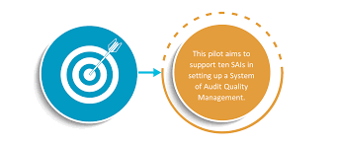
ERD
Expected outcomes
Design the logical structure of the system that includes all academic and career entities needed for student management, exam performance, instructors' performance, skill readiness, certification tracking, job placement, and Admin evaluation.
An ERD that enables building a normalized OLTP schema suitable for transactional operations and later transformation into dimensional models.

Slide 15
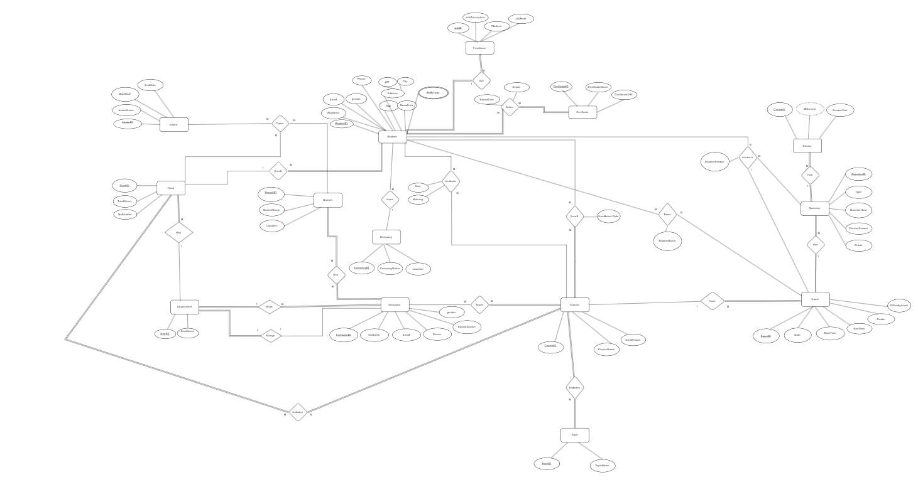

Slide 16
Mapping & Schema Design
Expected outcomes
A fully normalized, modular SQL schema is implemented.
Referential integrity is ensured across schemas using FKs and constraints.
Reusable views and joins form the basis for data warehouse loading.

Slide 17
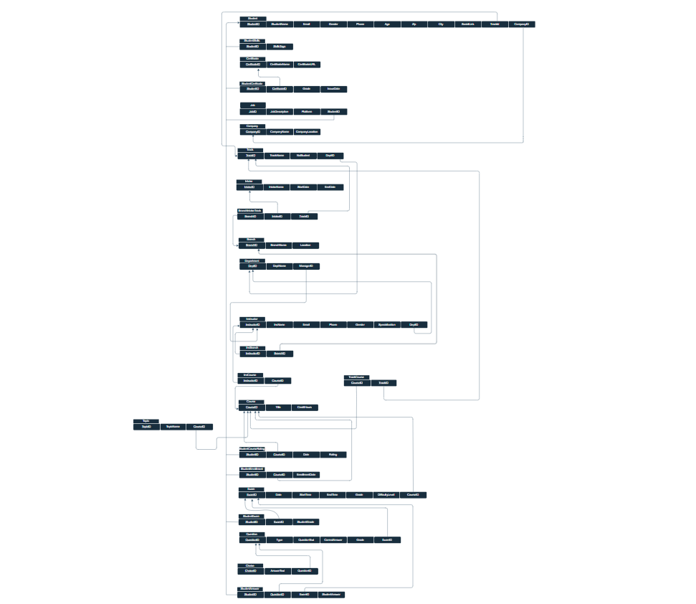

Slide 18
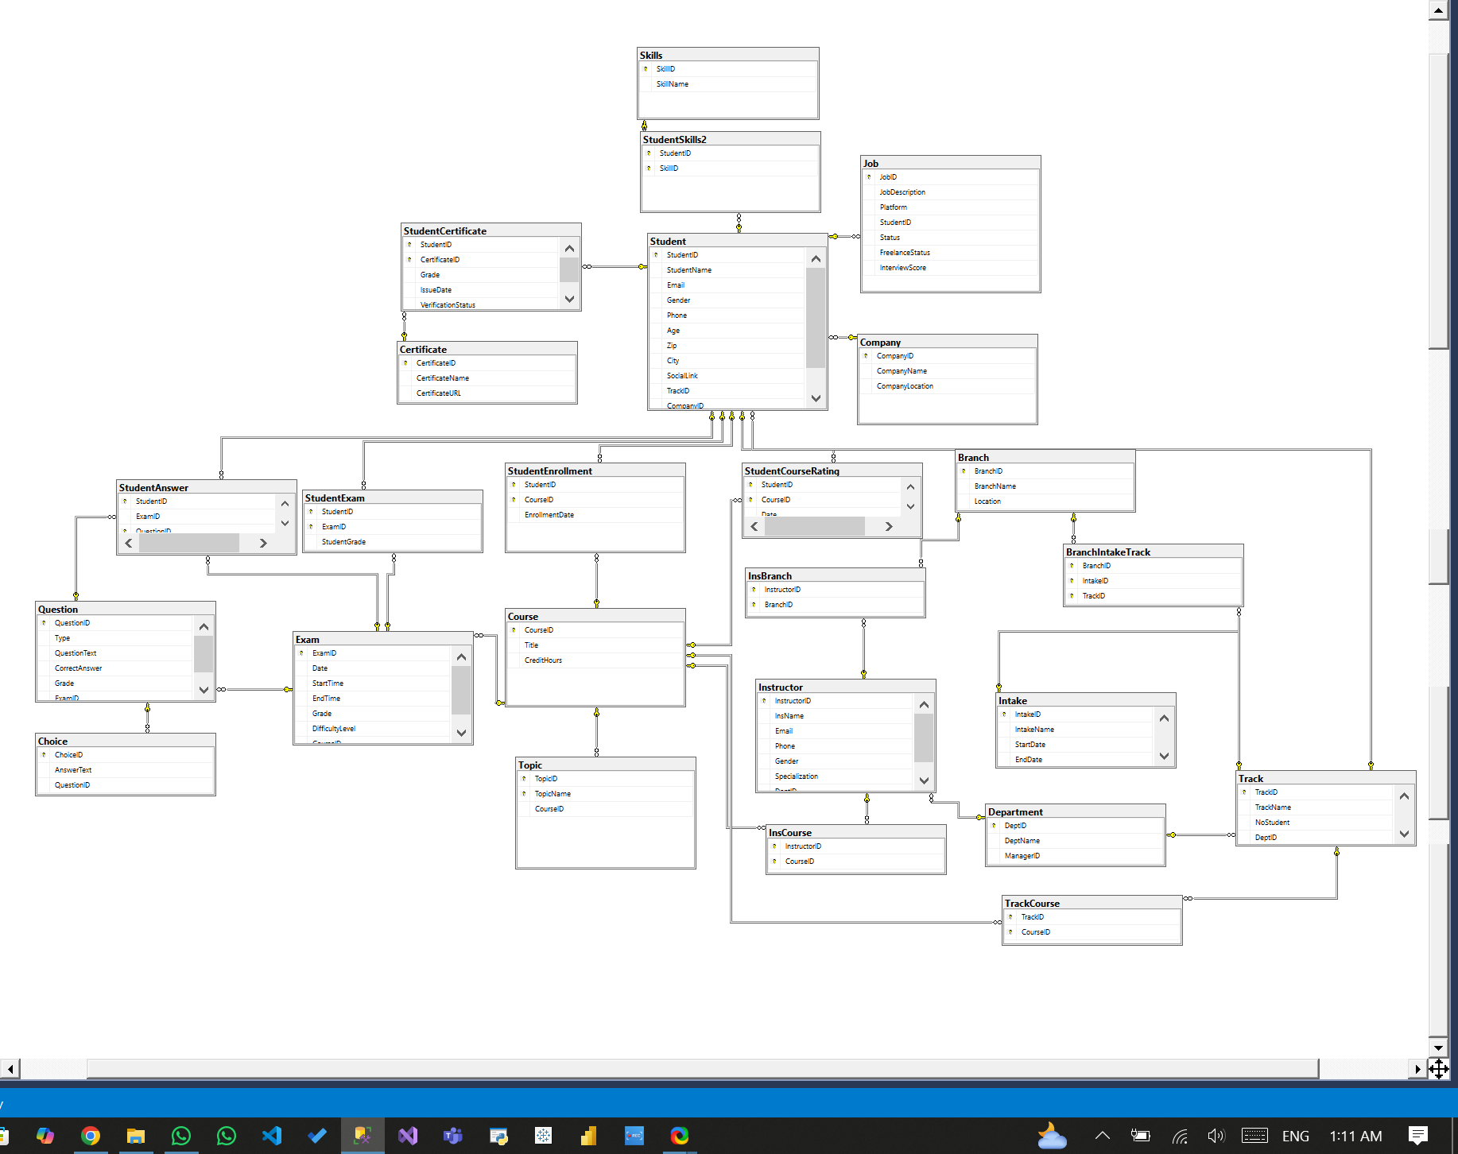

Slide 19
Data Population
Expected outcomes
All normalized tables are populated with consistent mock data.
Data supports full end-to-end testing of dashboards and reports.
Diverse patterns ensure that filters, KPIs, and drilldowns can be tested.

Slide 20
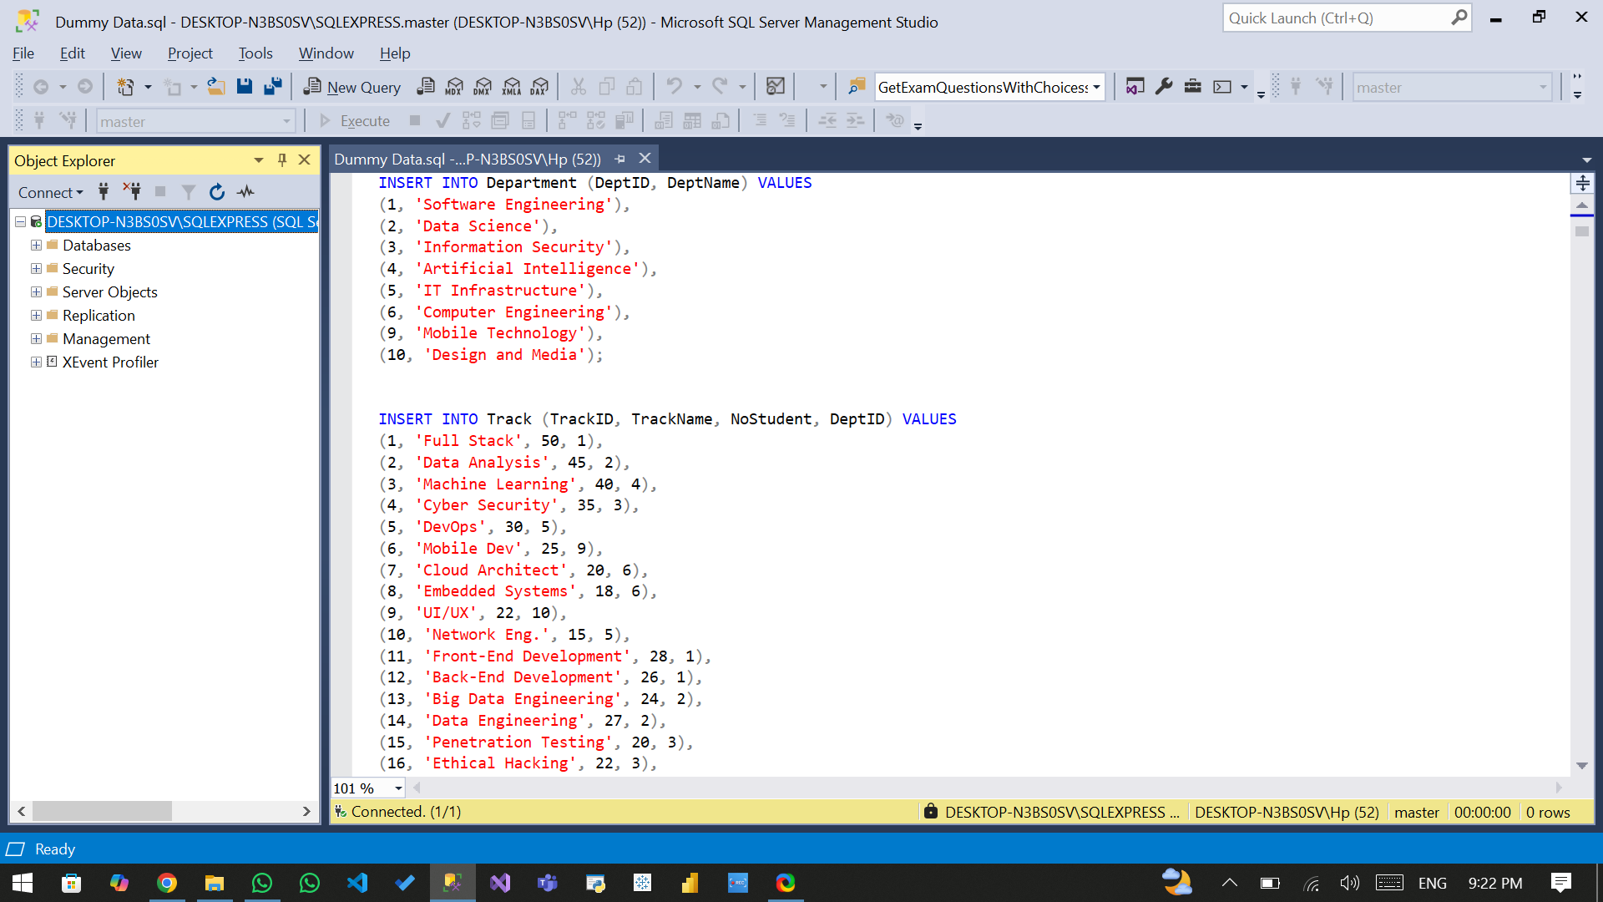

Slide 21
Stored Procedures(SPs)
Expected outcomes
CRUD
InsertStudent
UpdateStudent
DeleteStudent
SelectAllStudents
Exam Ops
GenerateExam
GetExamAnswers
CorrectExam
Admin
sp_DeleteAllData
SSRS Reports
sp_GetGradesByStudent
sp_GetExamQuestionsWithChoices
sp_GetGradesByStudent
sp_GetInstructorCoursesSummary
sp_GetCourseTopics
sp_GetStudentAnswersWithCorrection

Slide 22
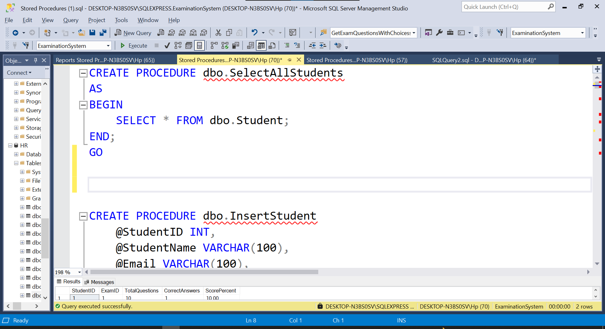
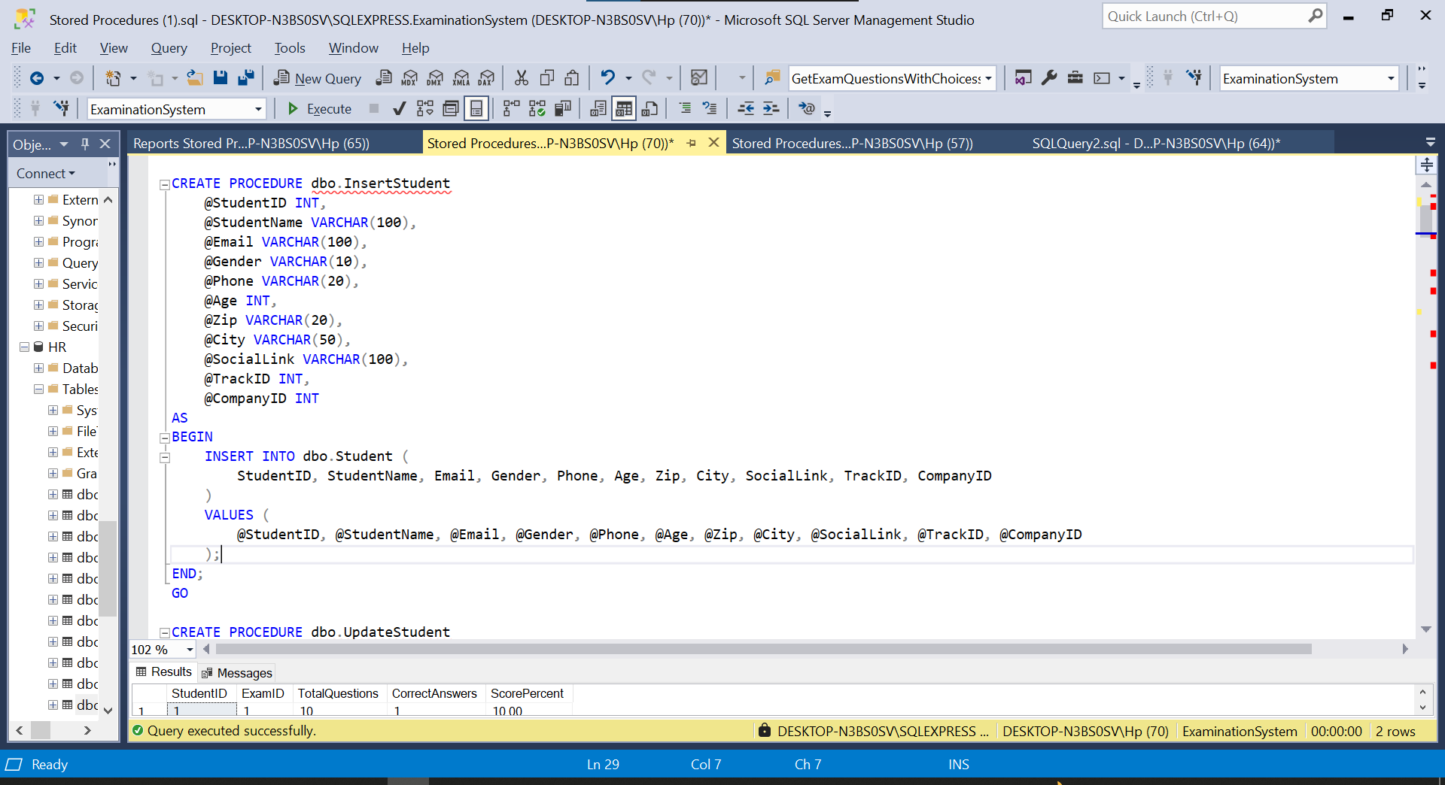
SelectAllStudents
InsertStudents

Slide 23
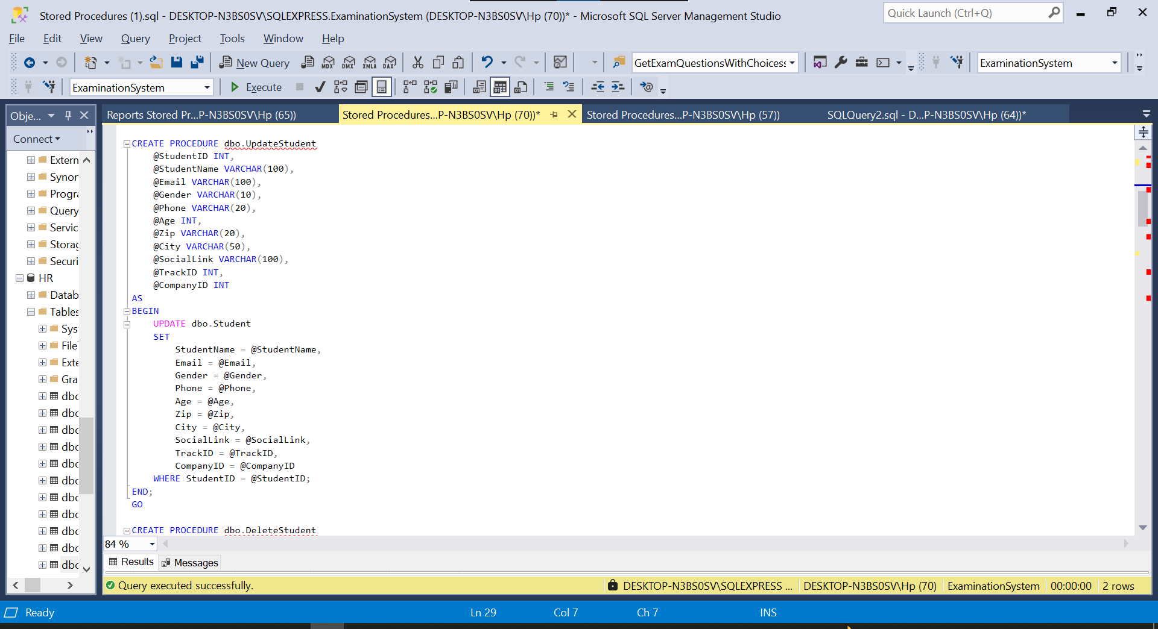
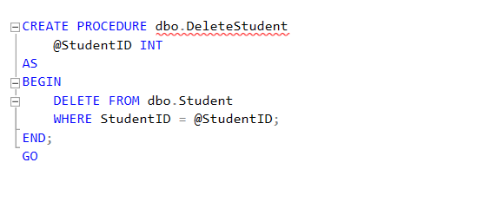
UpdateStudent
DeleteStudents

Slide 24
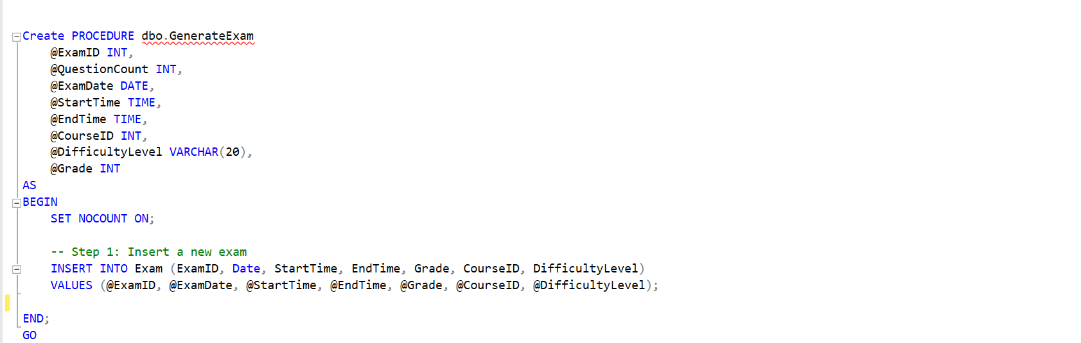
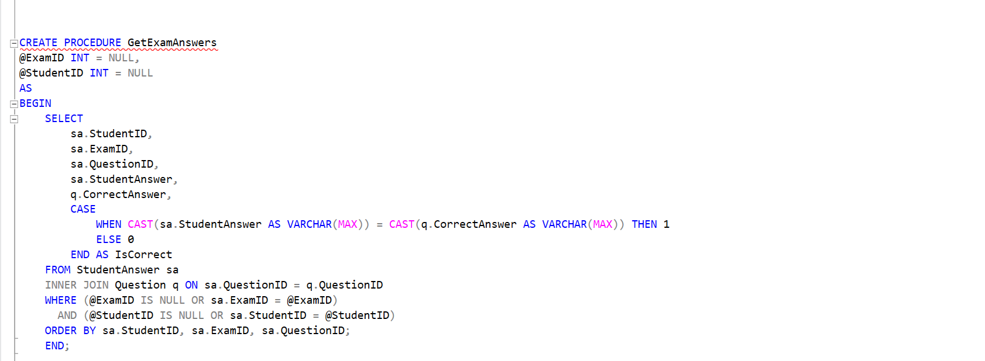
GenerateExam
GetExamAnswer

Slide 25
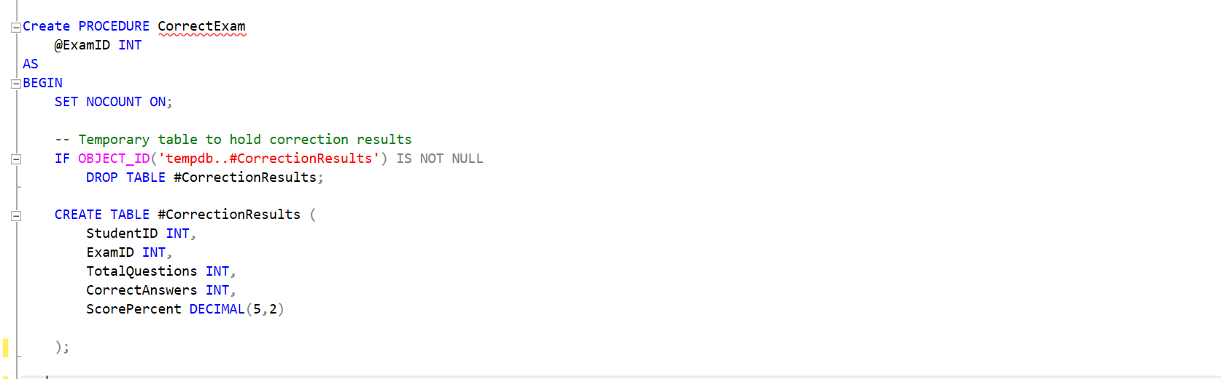
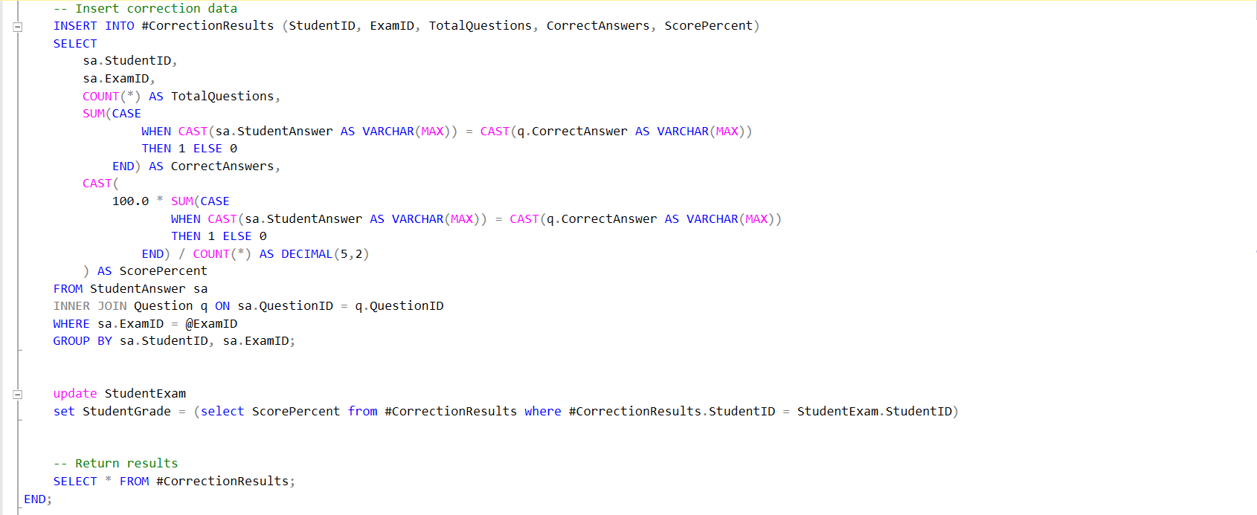
CorrectExam

Slide 26
DWH
Expected outcomes
Fully functioning star schema for academic analytics
Clean surrogate keys and dimensional separation
Perfectly suited for Power BI model, chatbot, and SSRS reporting
Ready for slicing by date, branch, course, or instructor

Slide 27
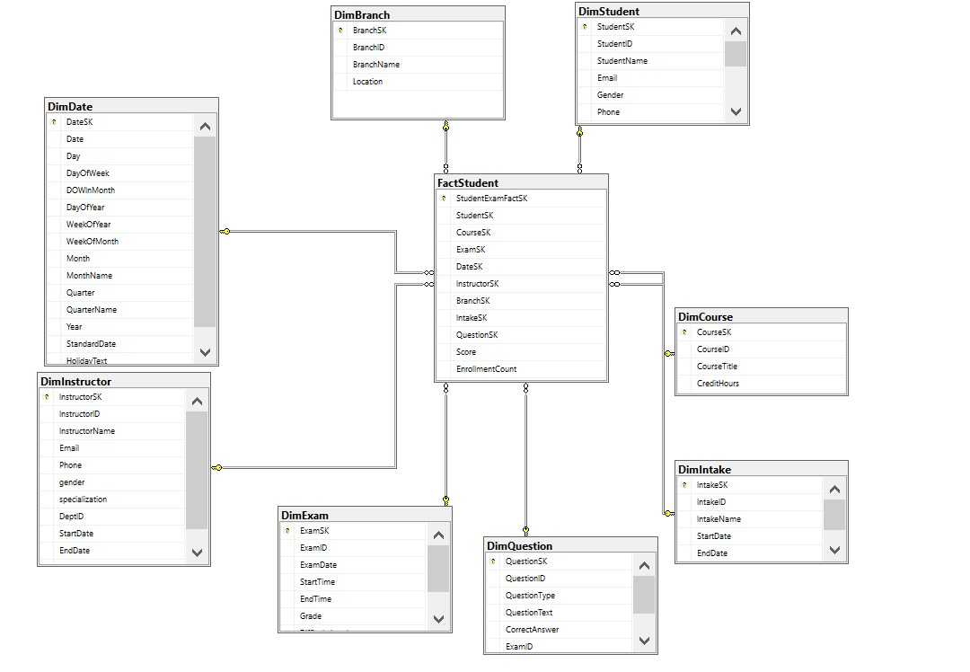

Slide 28
SSRS
Expected outcomes
6 SSRS reports developed using parameterized stored procedures.
All reports were deployed to Power BI Desktop for stakeholder access.
Reports support academic, administrative, and HR-related analysis.

Slide 29
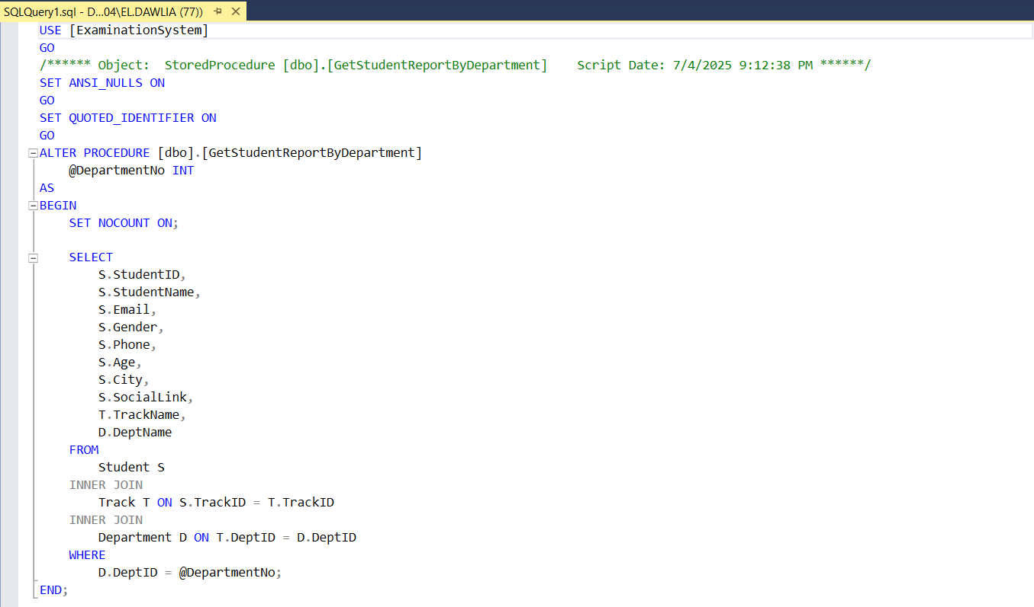

Slide 30
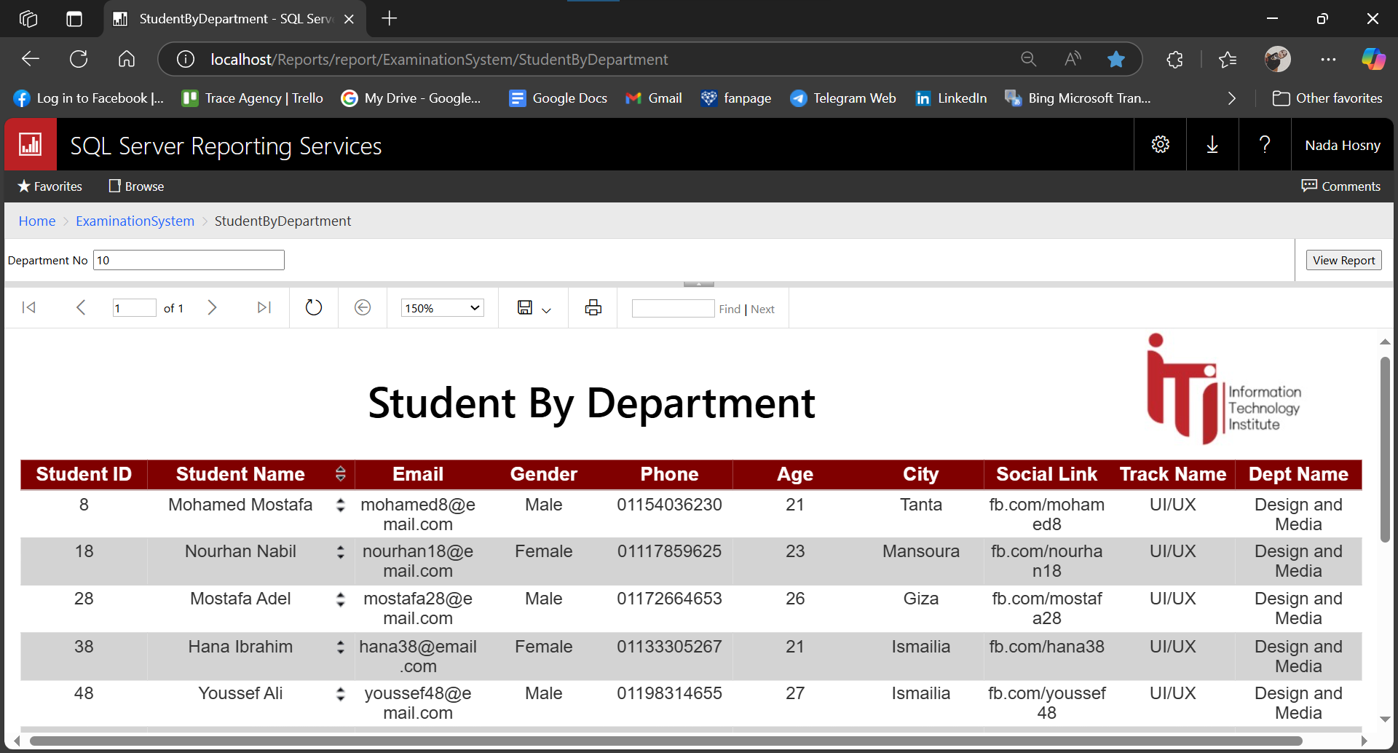

Slide 31
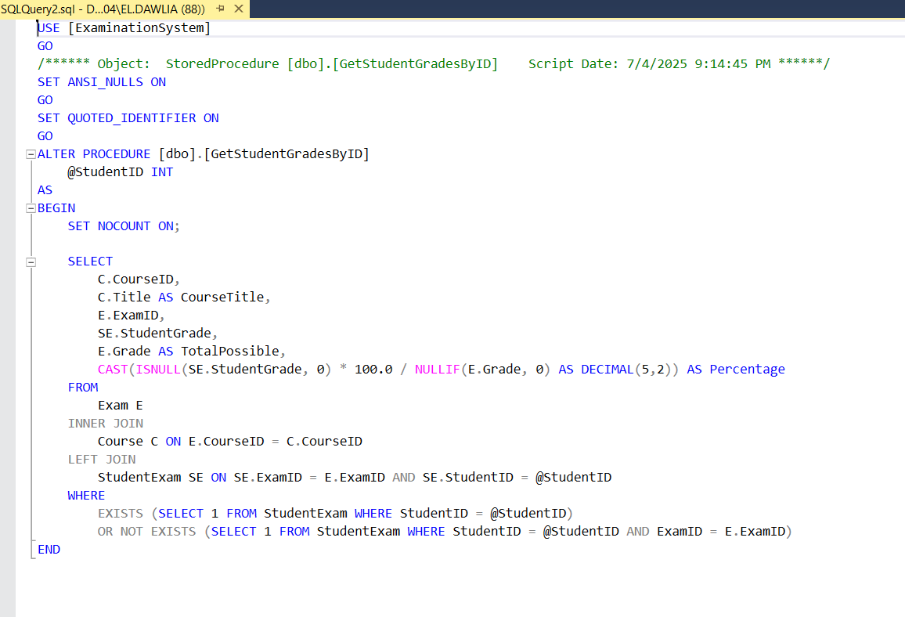

Slide 32
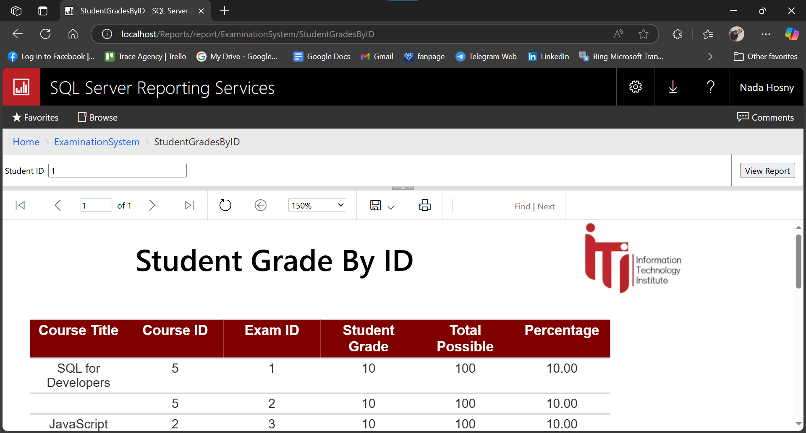

Slide 33
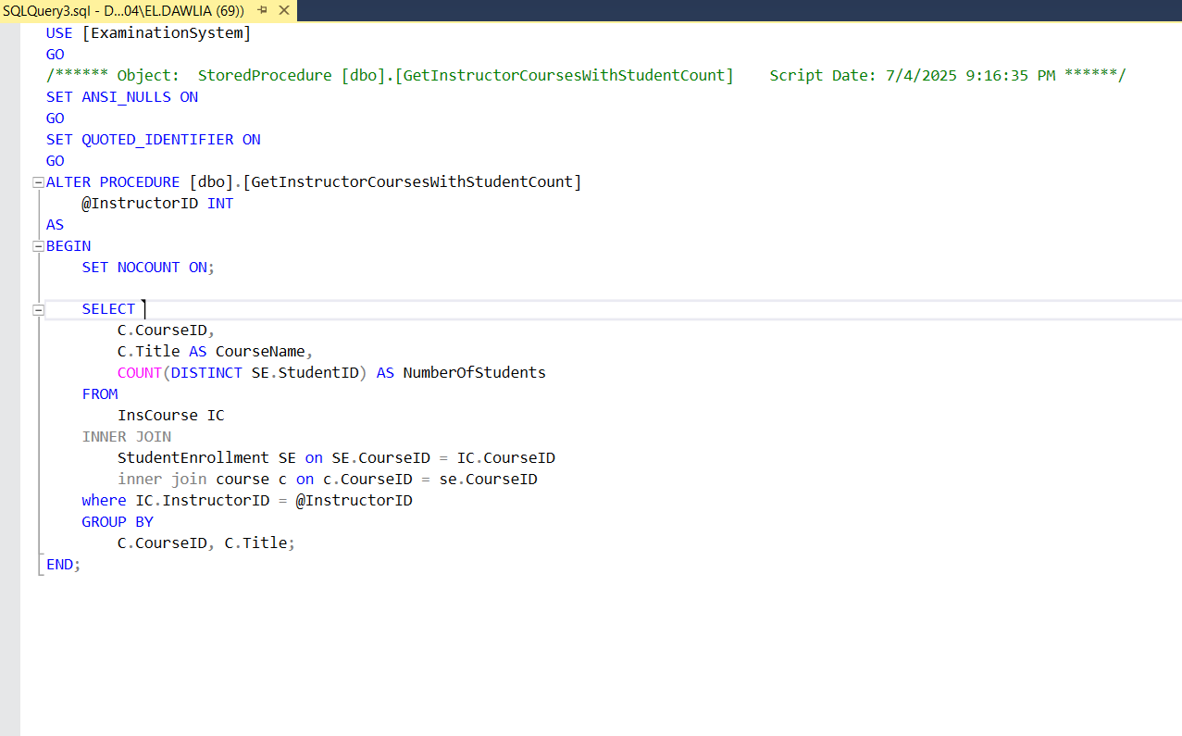

Slide 34
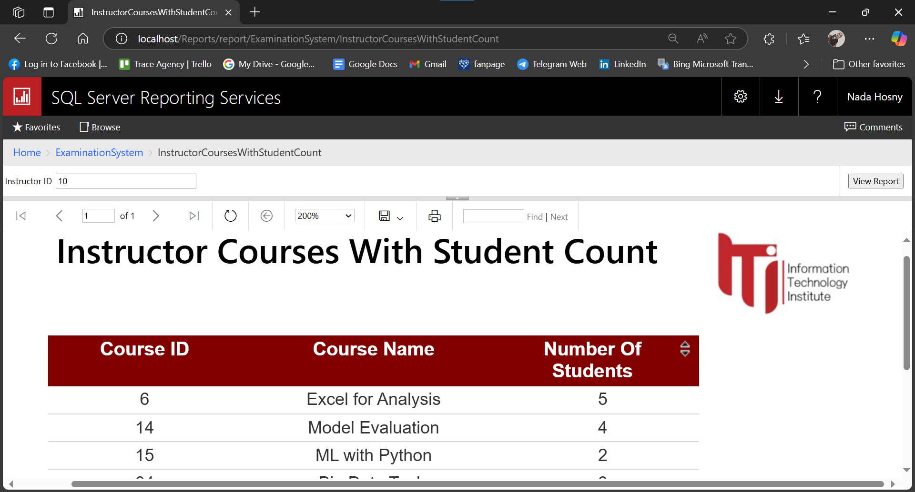

Slide 35
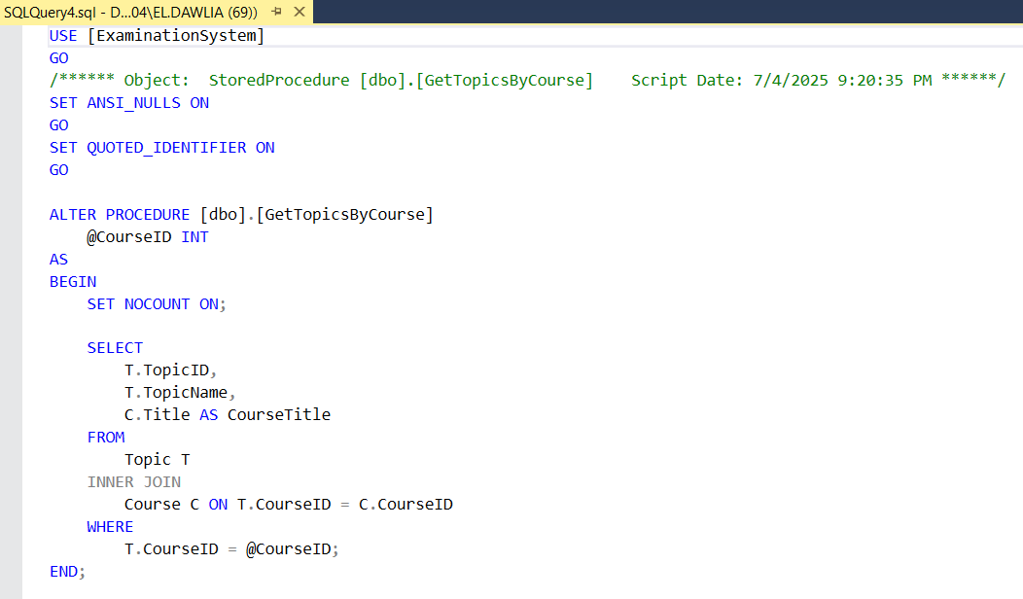

Slide 36
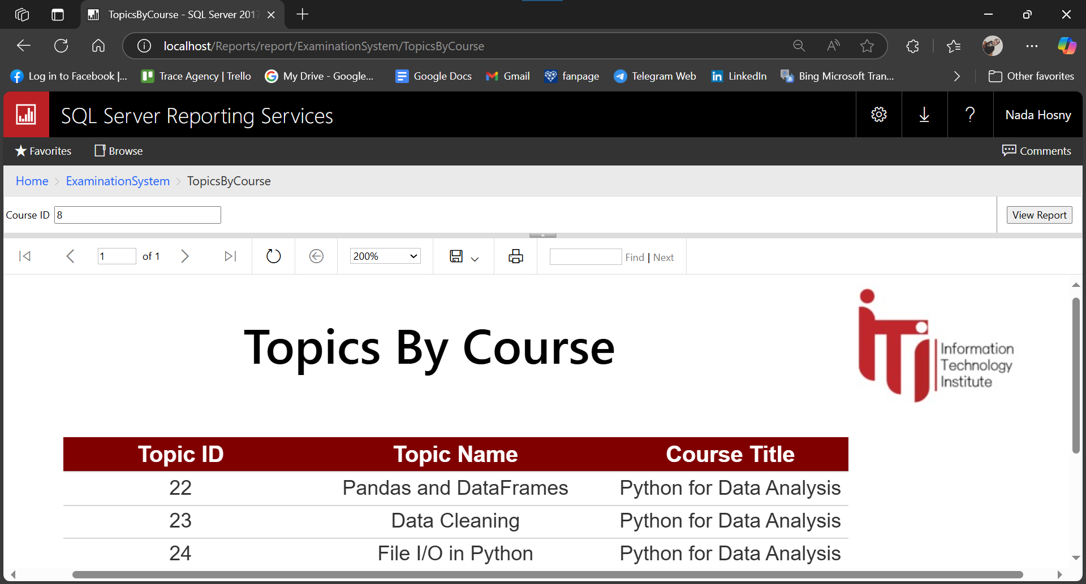

Slide 37
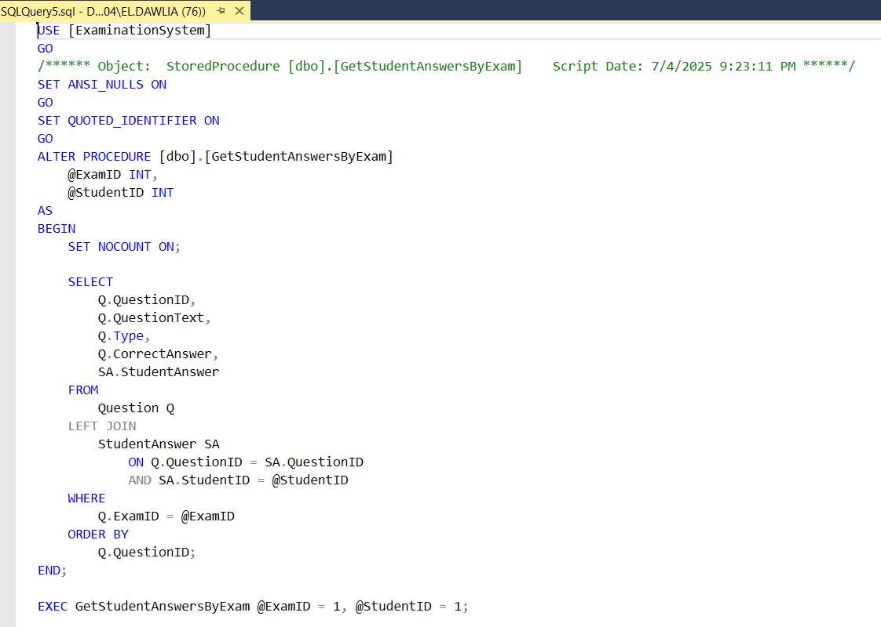

Slide 38
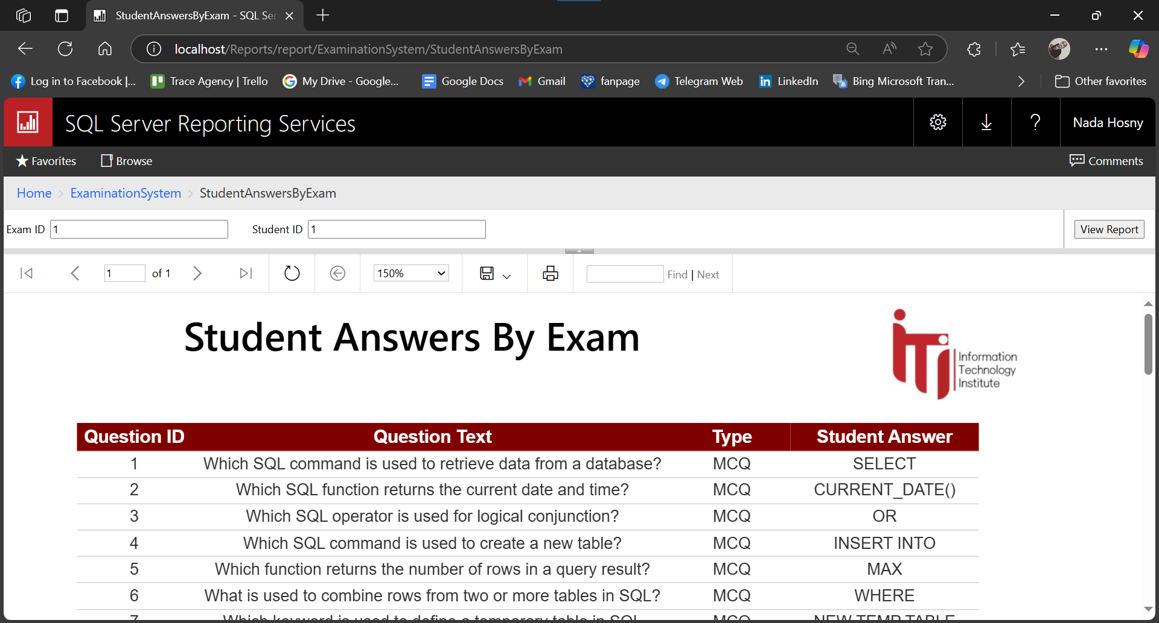

Slide 39
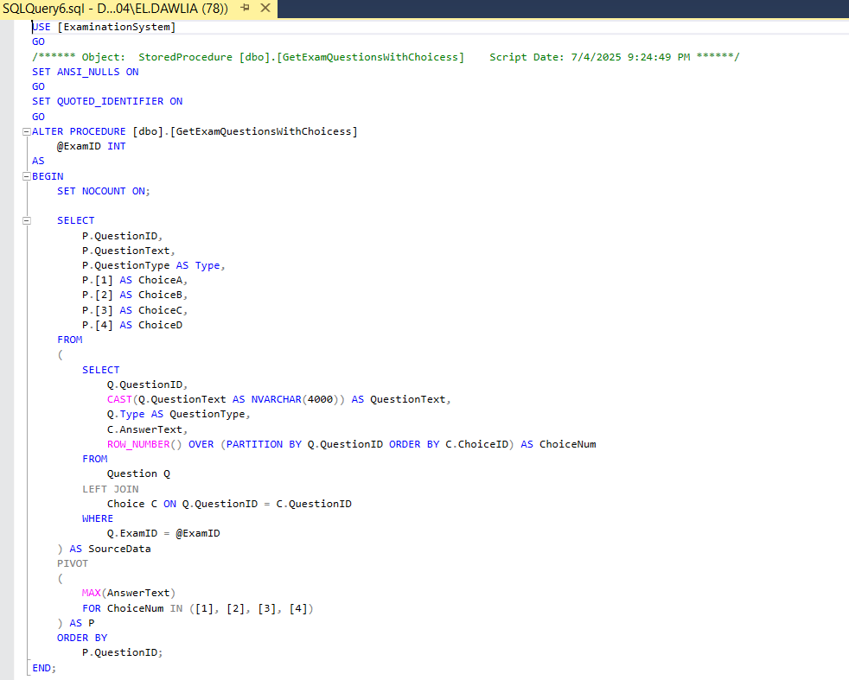

Slide 40
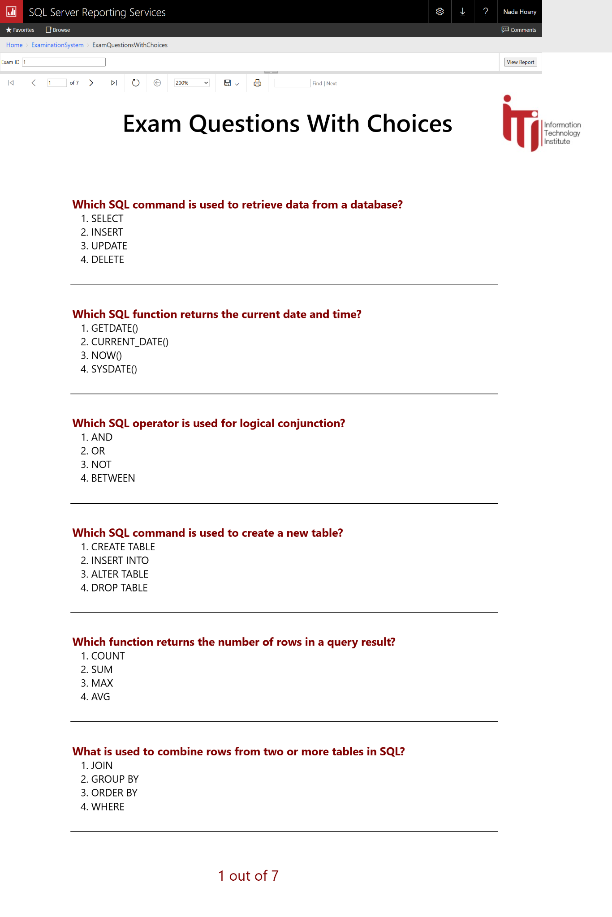

Slide 41
REPORTS DEPLOYMENT ON POWER BI

Slide 42
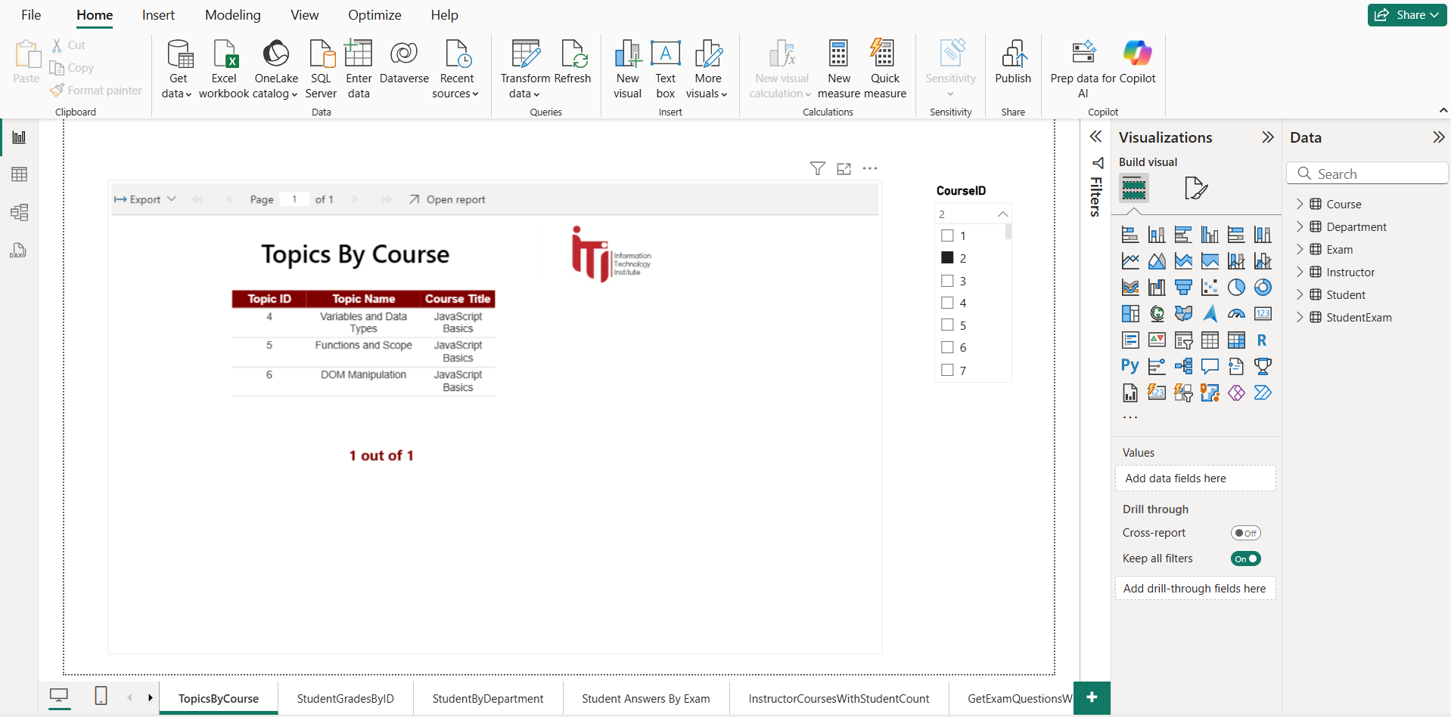

Slide 43
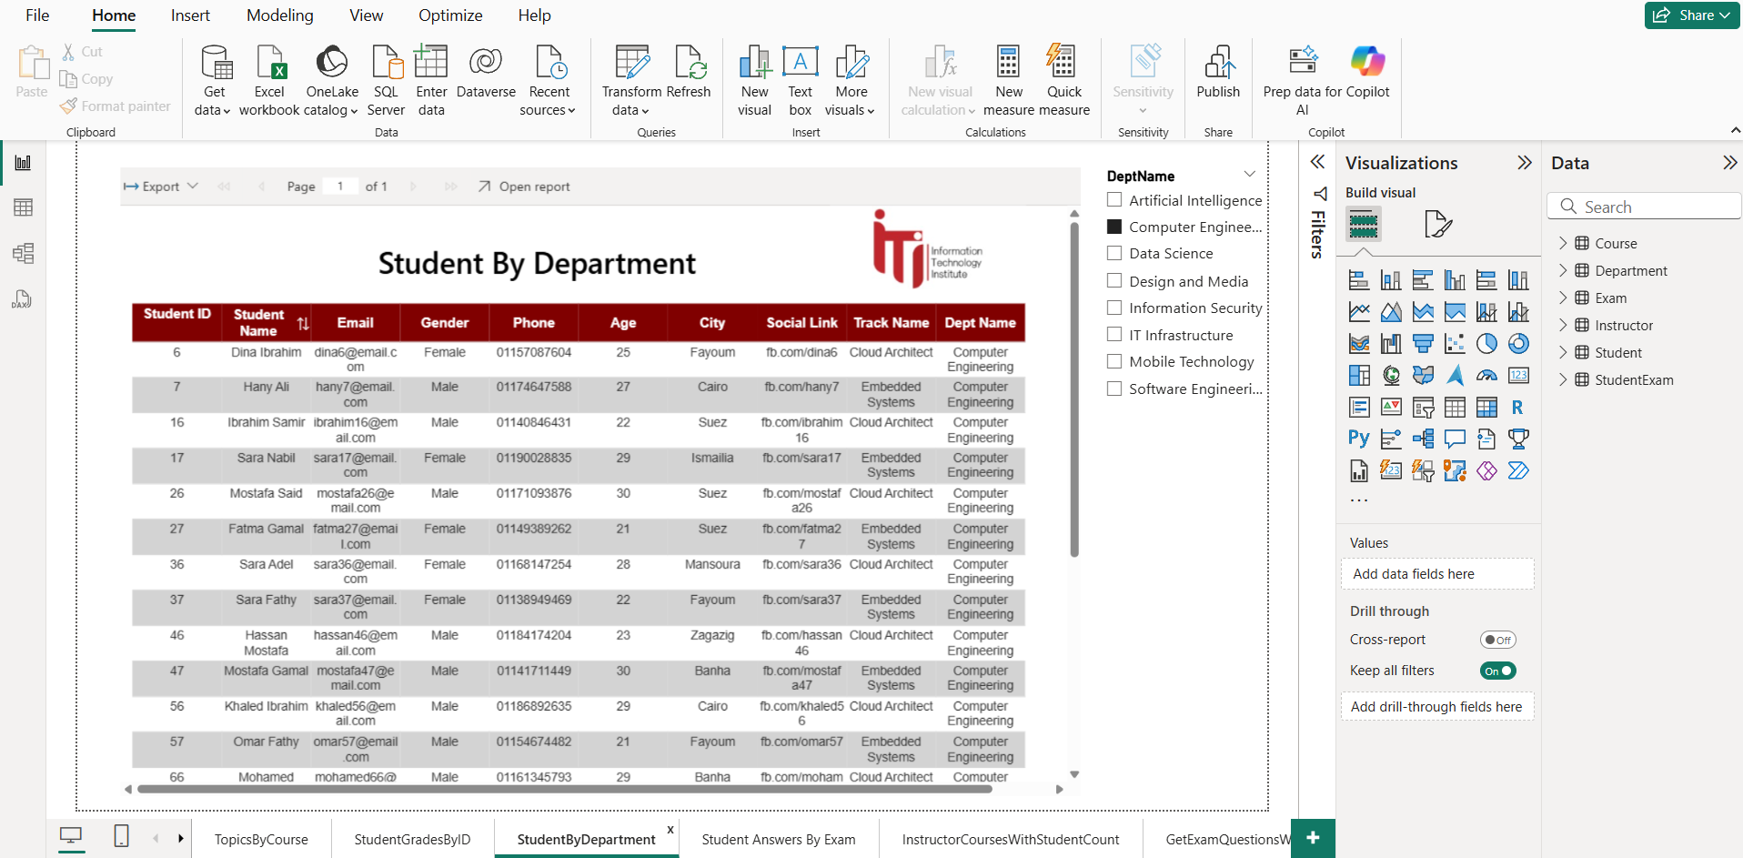

Slide 44
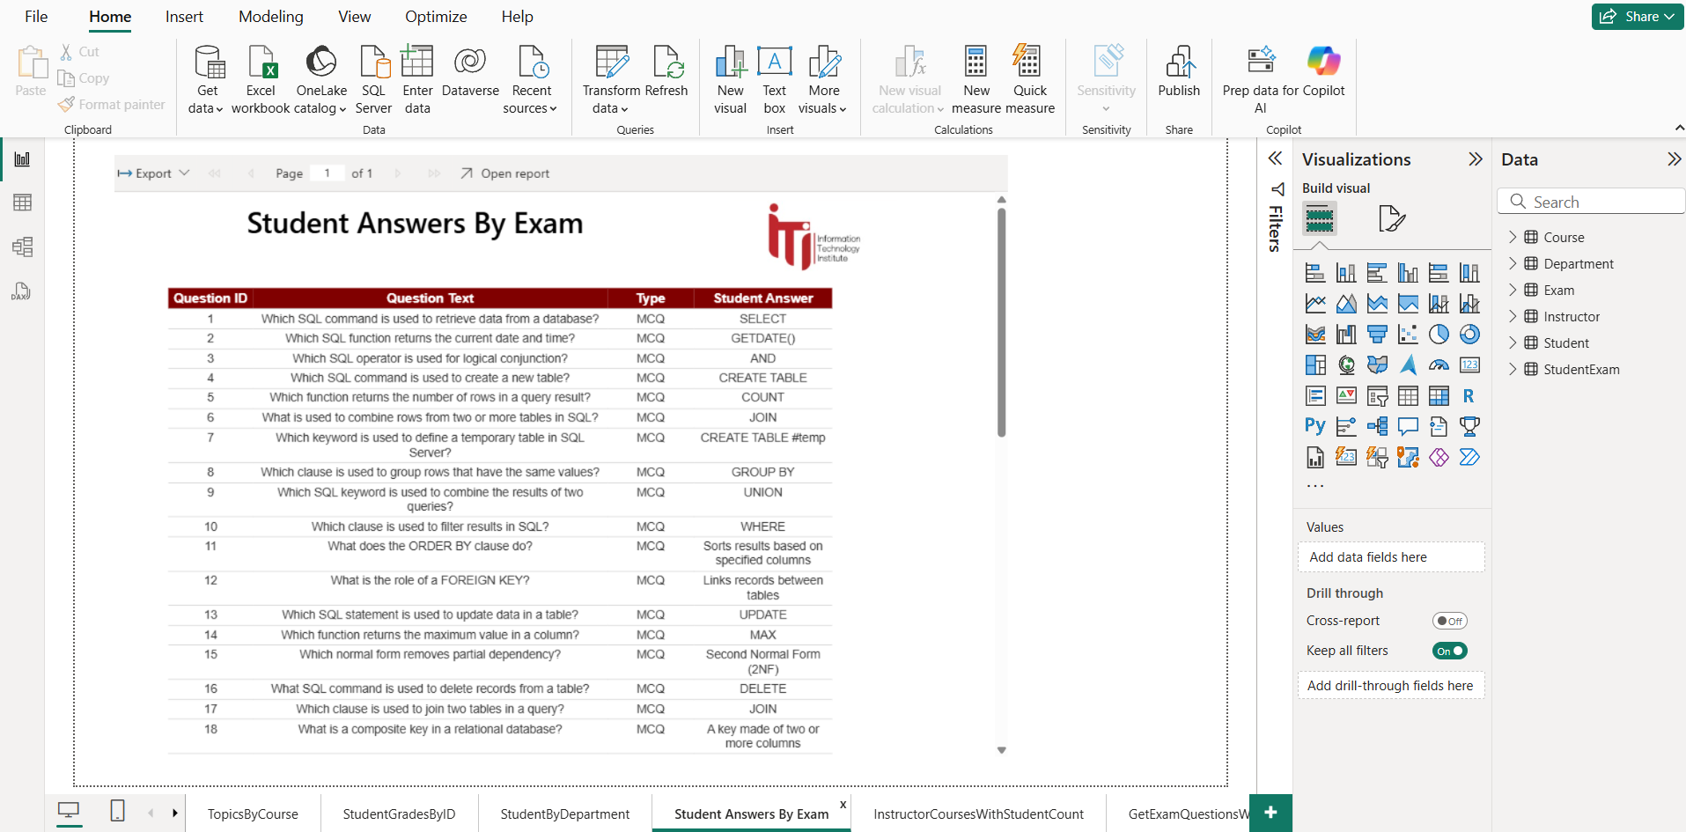

Slide 45
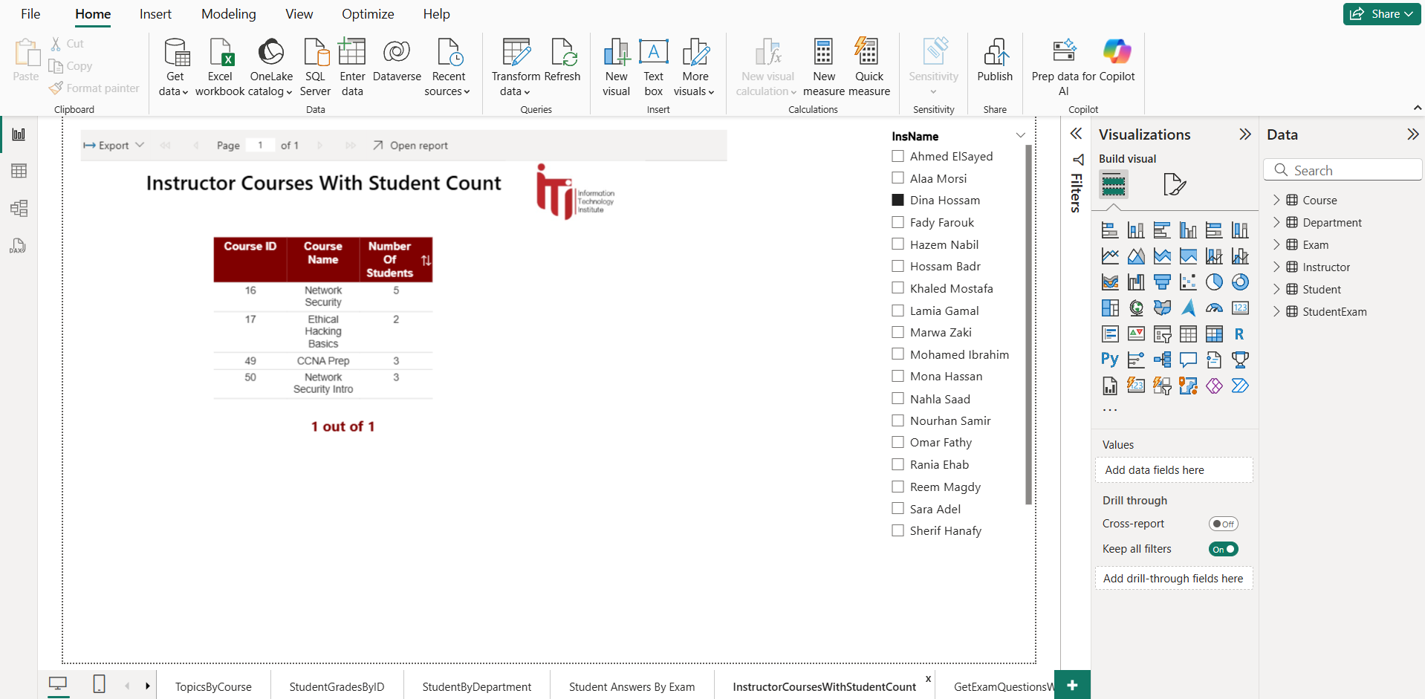

Slide 46
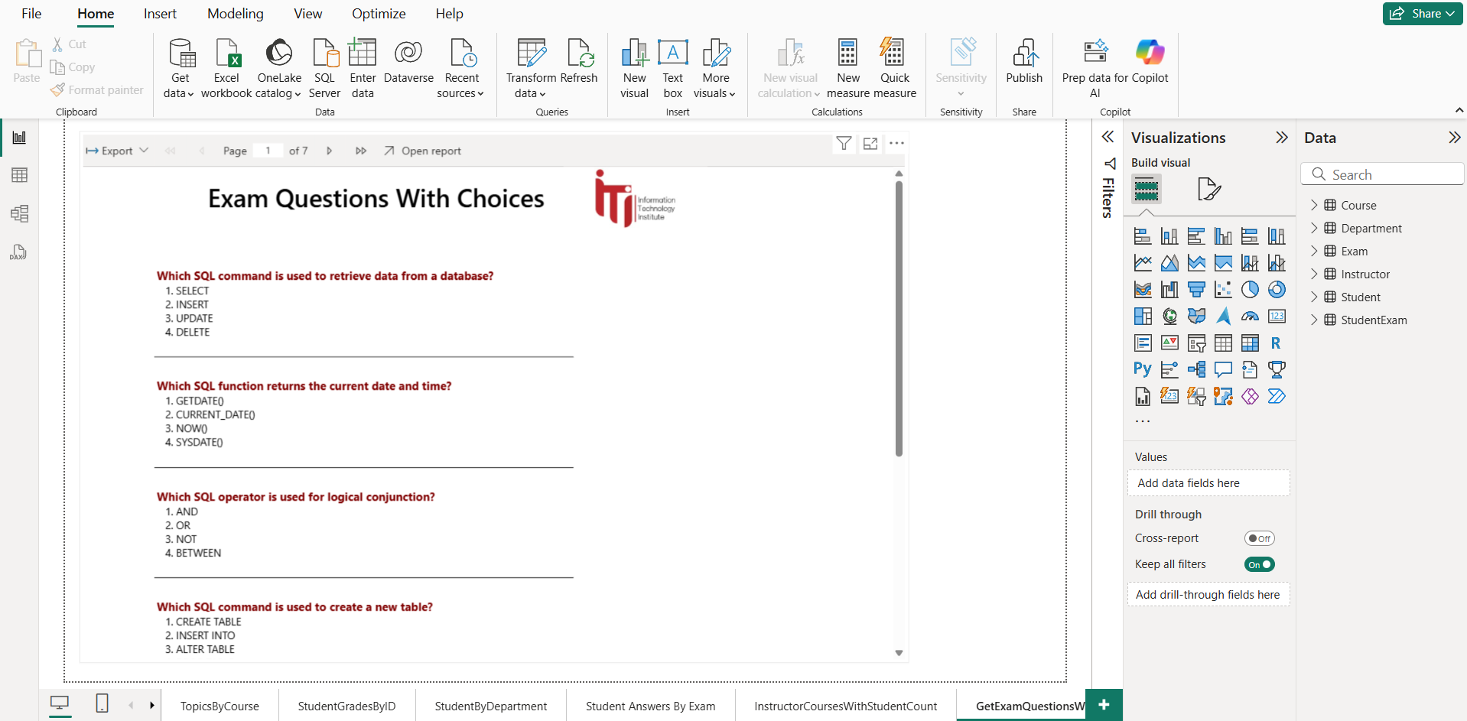

Slide 47
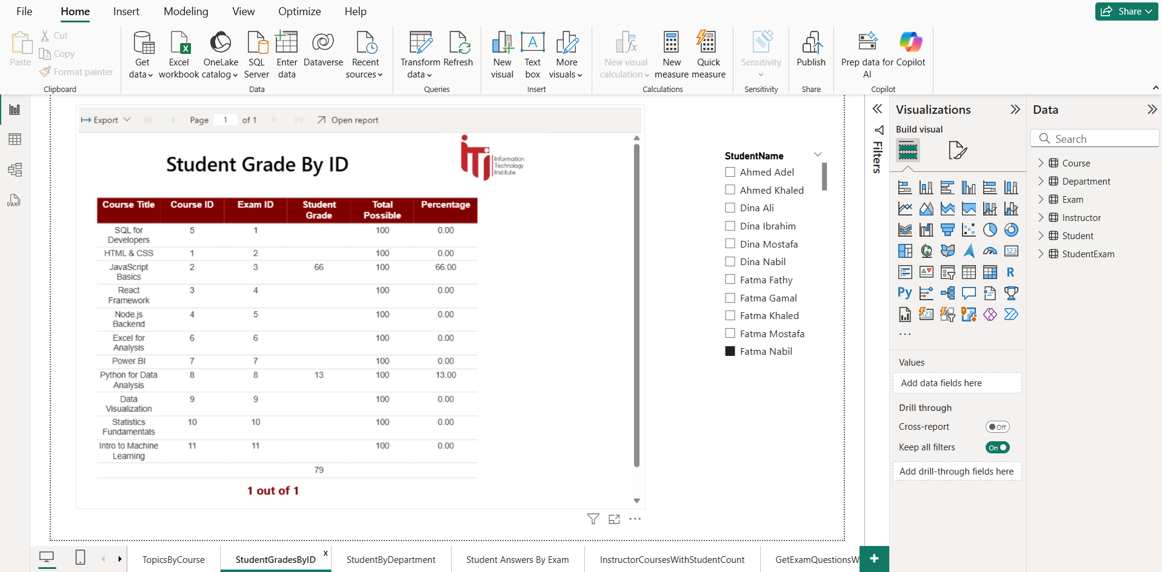

Slide 48
Dashboards
Expected outcomes
+20 Dashboards completed from the student, instructor, Admin, and HR view
All DAX measures were optimized
Reusable, responsive, clean layout for business users
Highly interactive: slicing by date, intake, Branch, or track
Consistent visual identity across dashboards

Slide 49
Instructor Dashboard

Slide 50
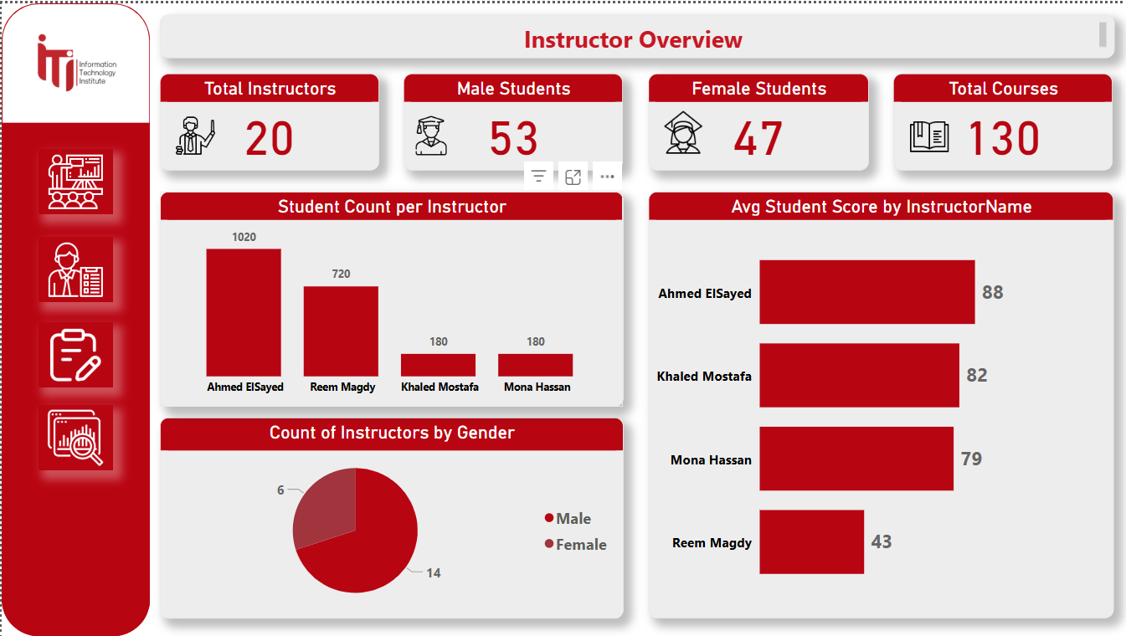

Slide 51
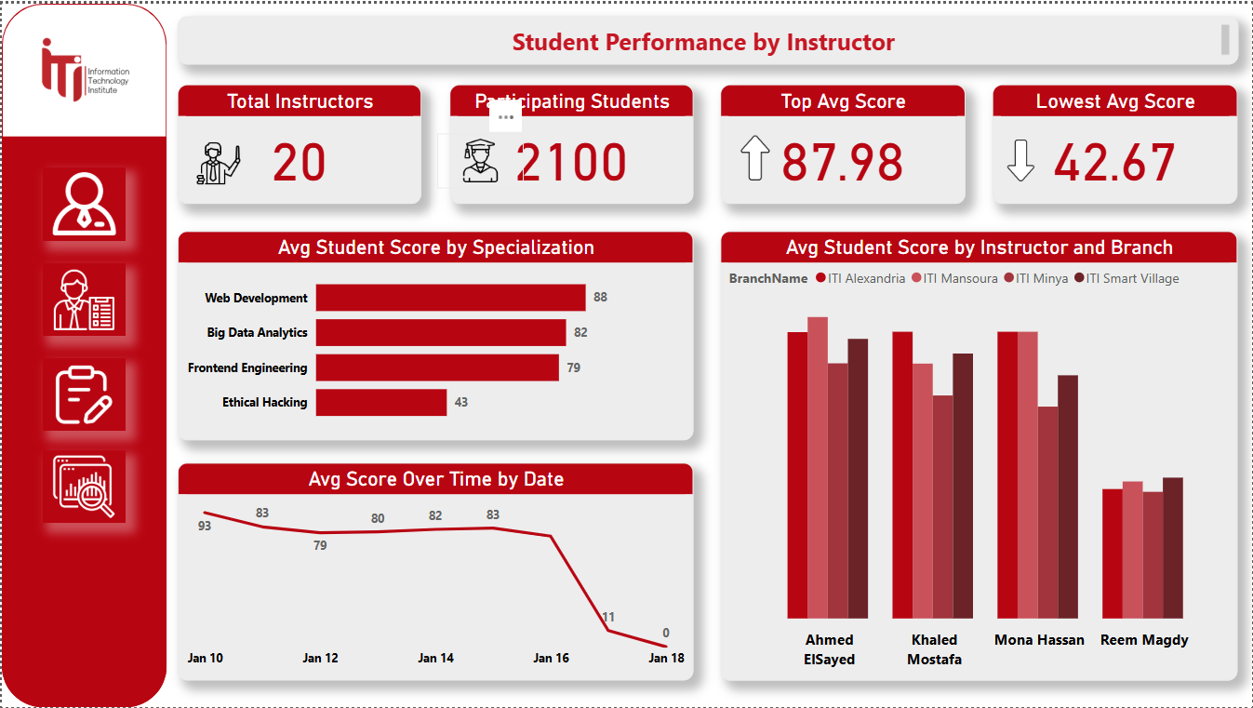

Slide 52
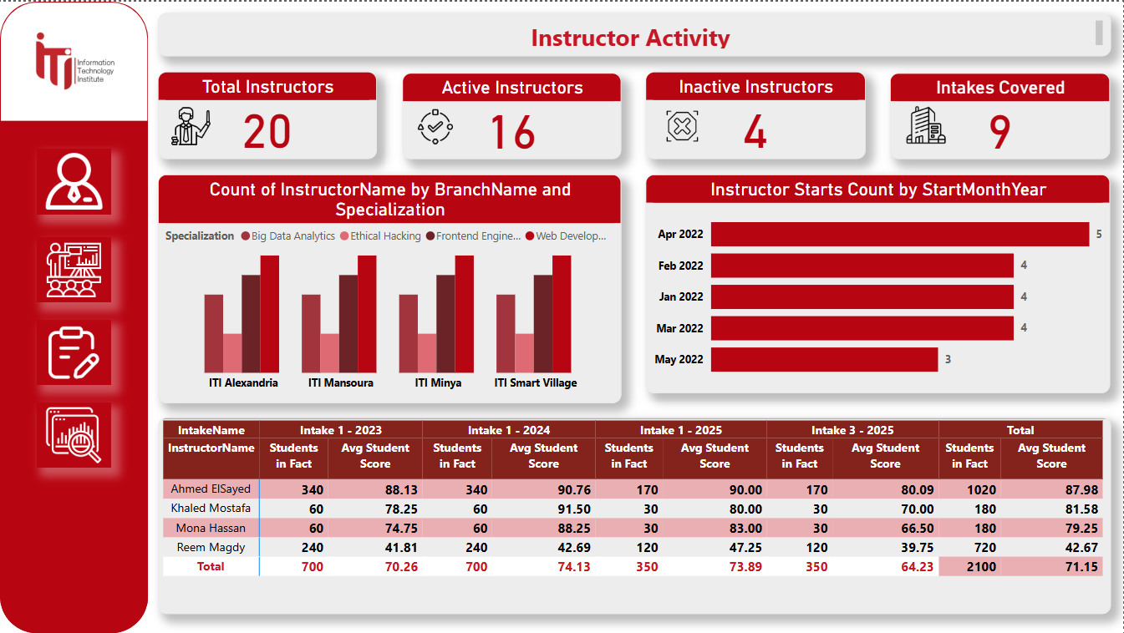

Slide 53
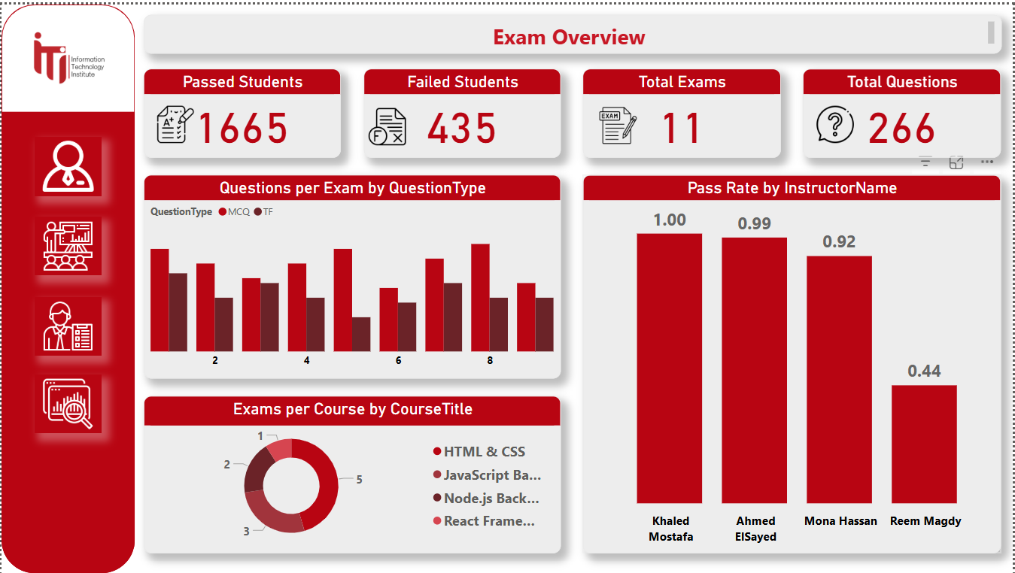

Slide 54
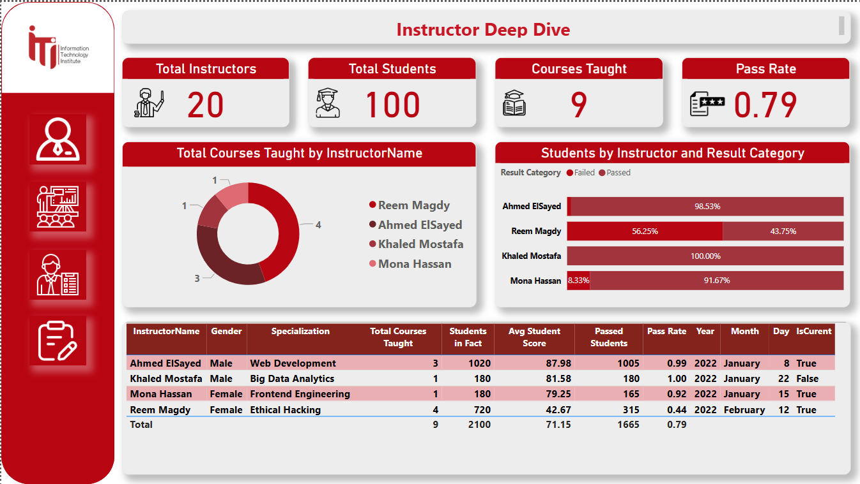

Slide 55
Admin Dashboard

Slide 56
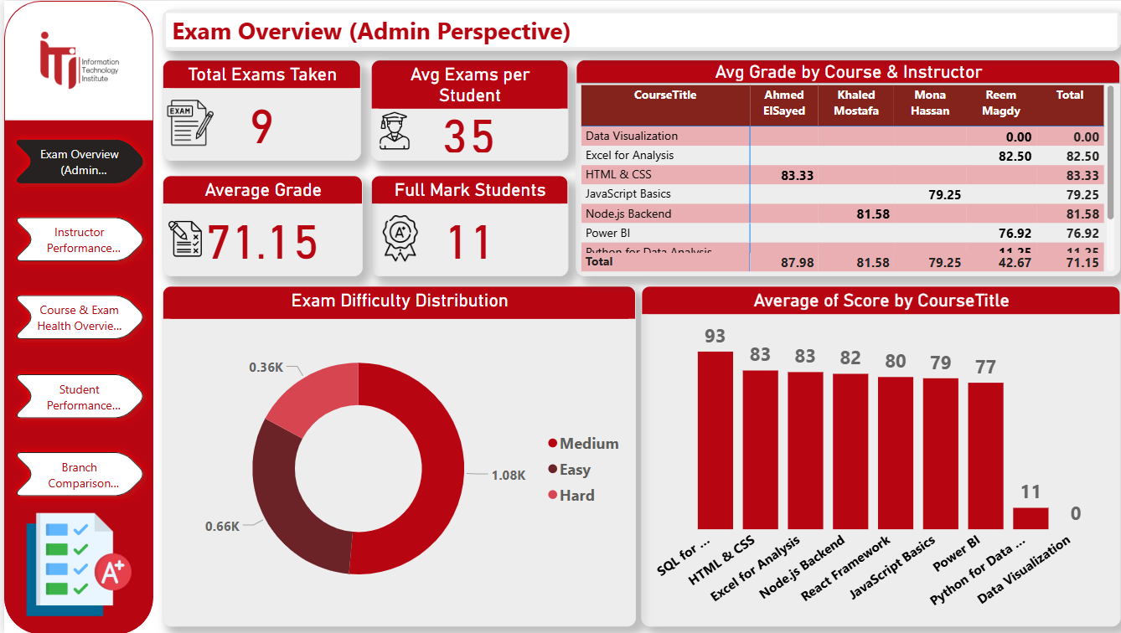

Slide 57
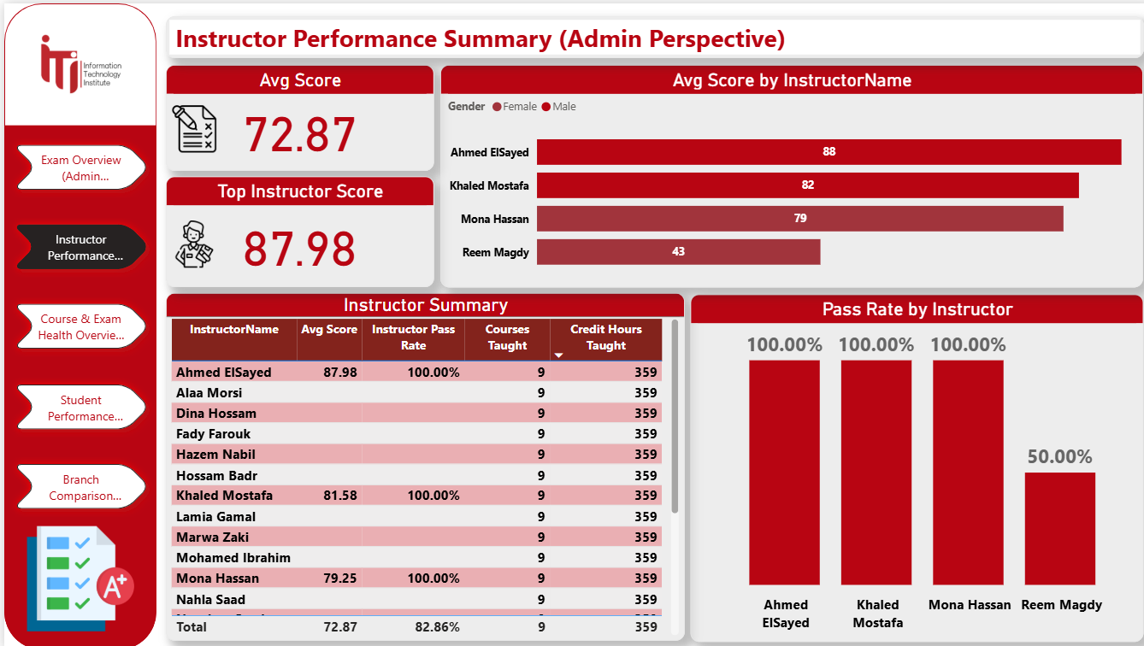

Slide 58
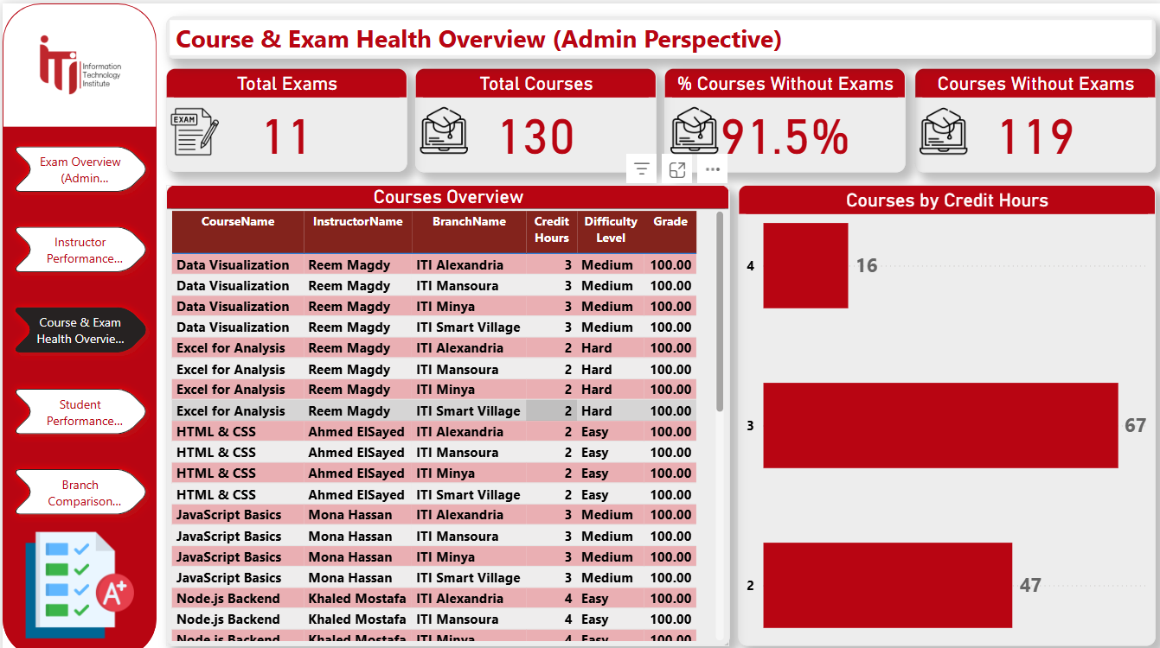

Slide 59
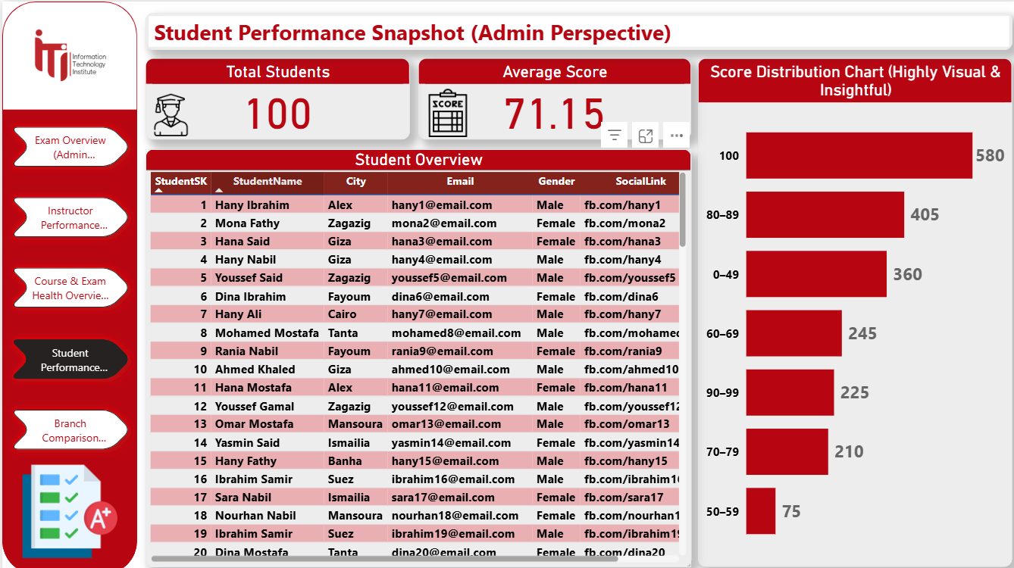

Slide 60
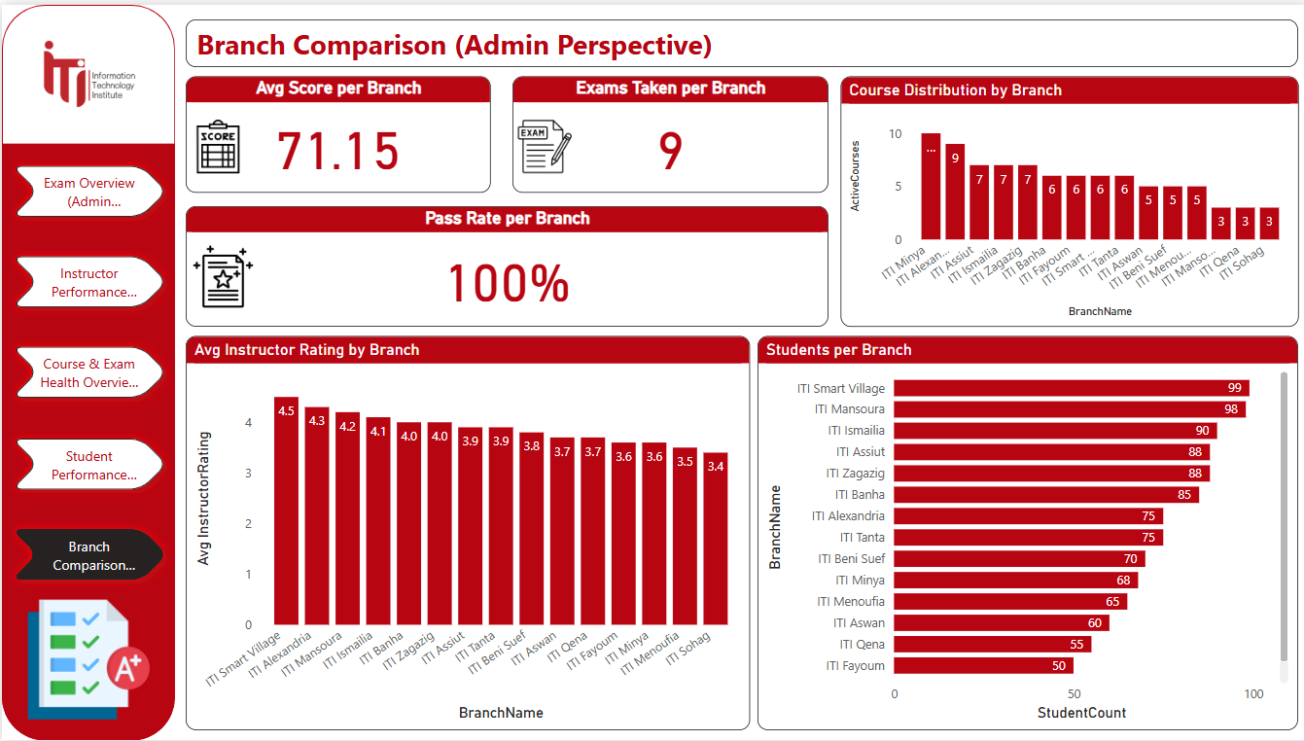

Slide 61
HR Data Mart
Expected outcomes
Create a centralized, denormalized star schema that allows fast, intuitive, and insightful reporting for:
Performance analytics
Skill readiness
Certification tracking
Job placement
Interviewer feedback

Slide 62
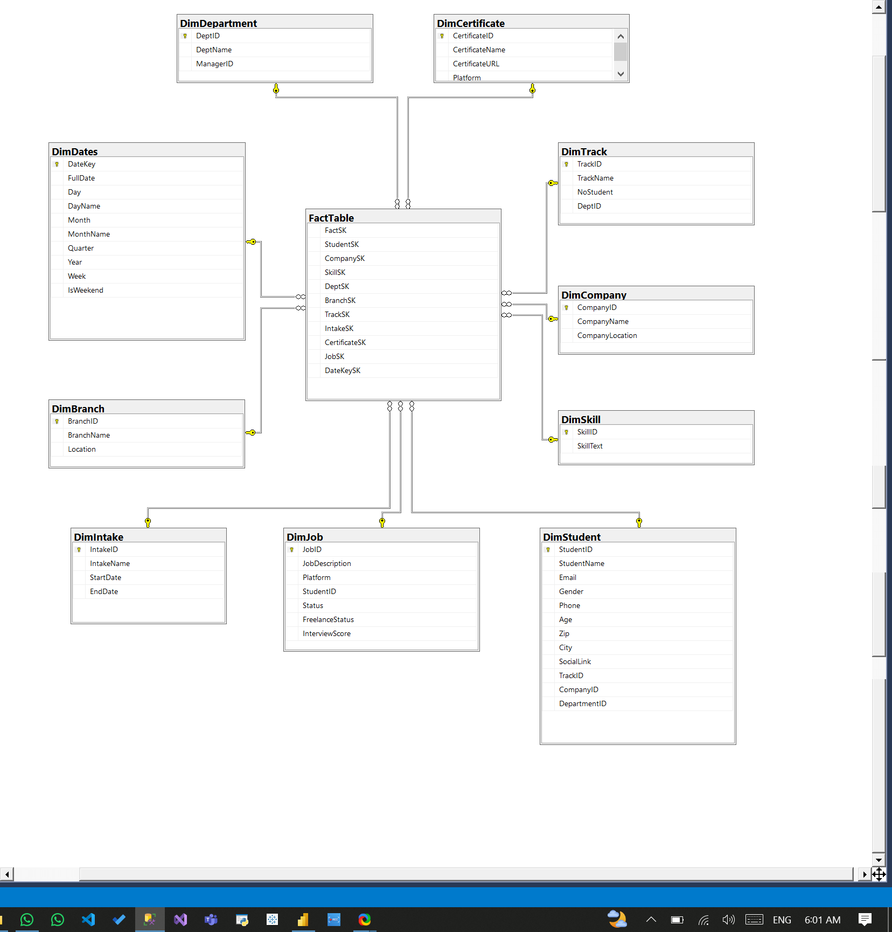

Slide 63
SSIS
Expected outcomes
SSIS provides a robust, scalable ETL pipeline
Data in the DW and HR mart is clean, consistent, and ready for Power BI
Surrogate keys and default fallbacks prevent model breaks
Logical precedence ensures no FK violations

Slide 64
Recruiters' “HR” Dashboard

Slide 65
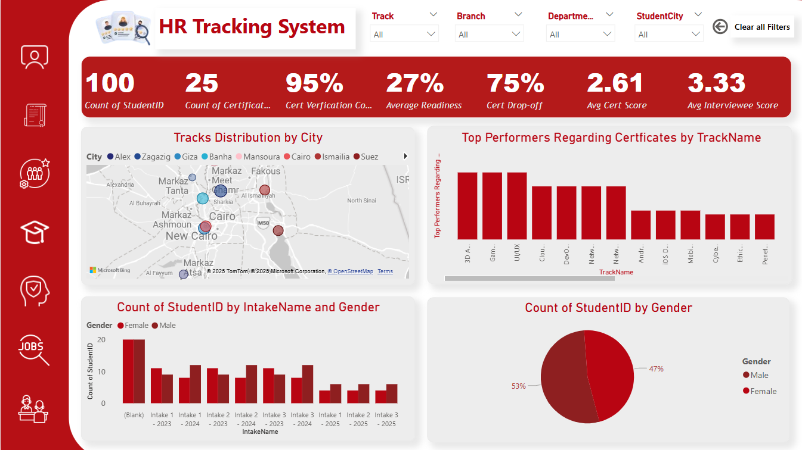

Slide 66
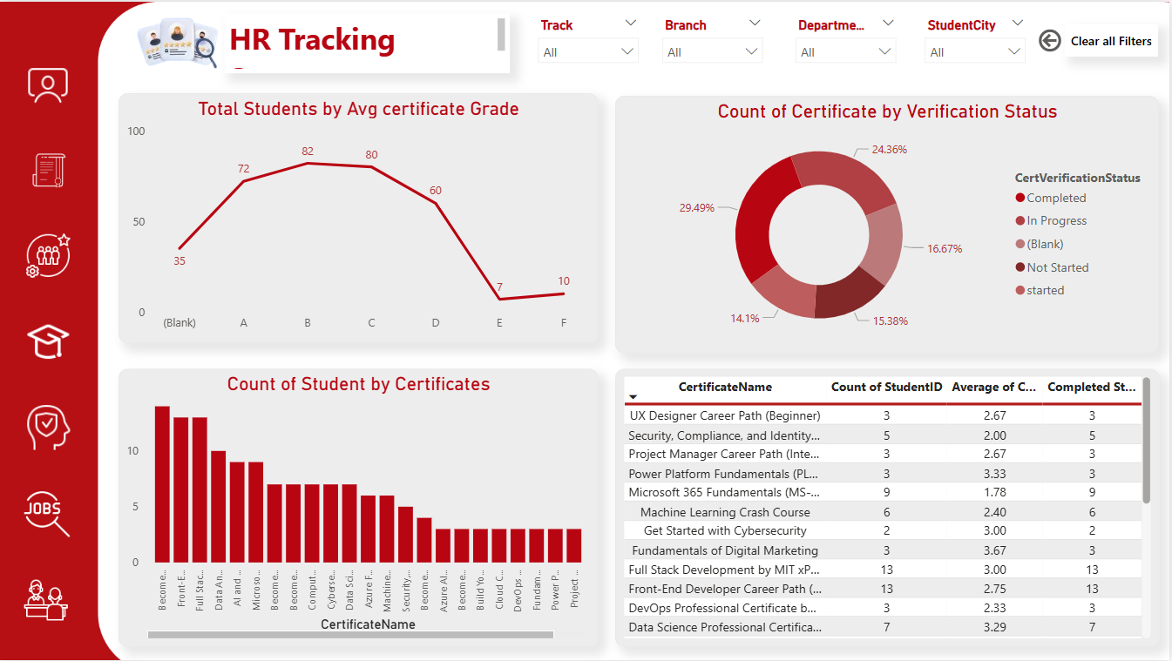

Slide 67
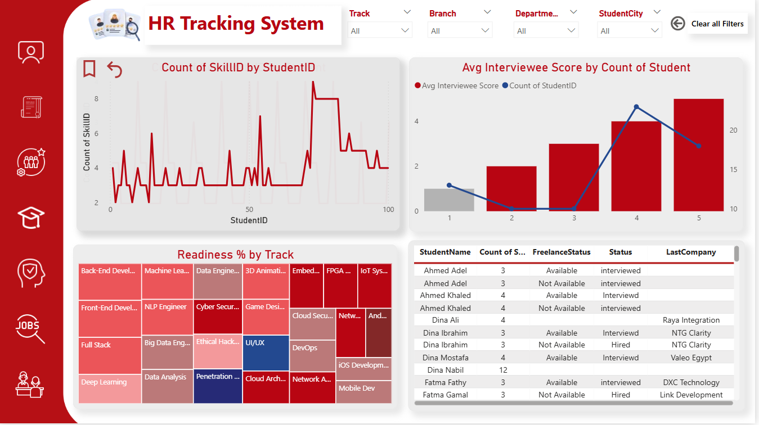

Slide 68
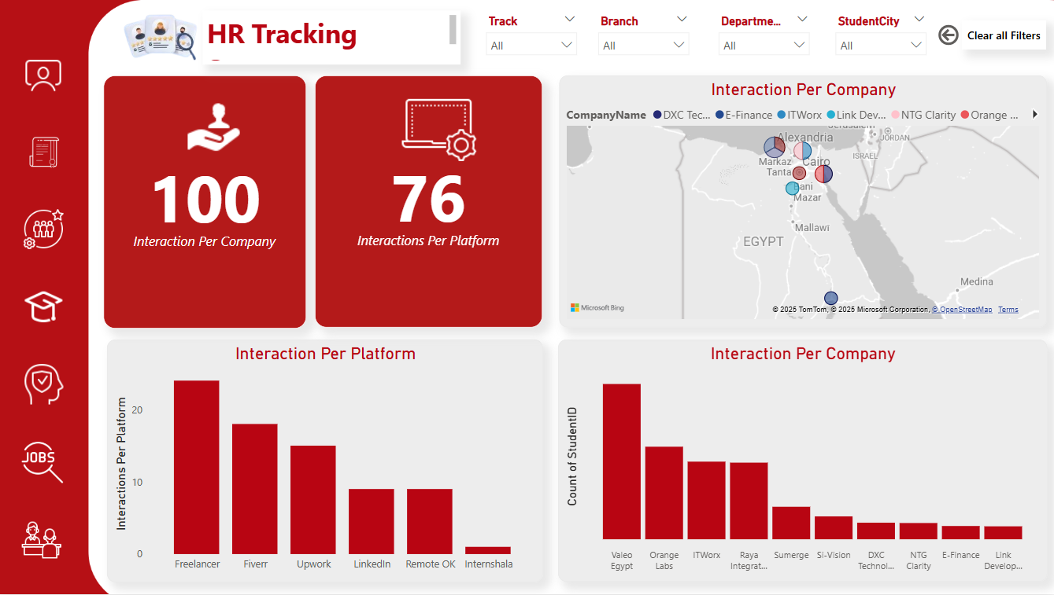

Slide 69
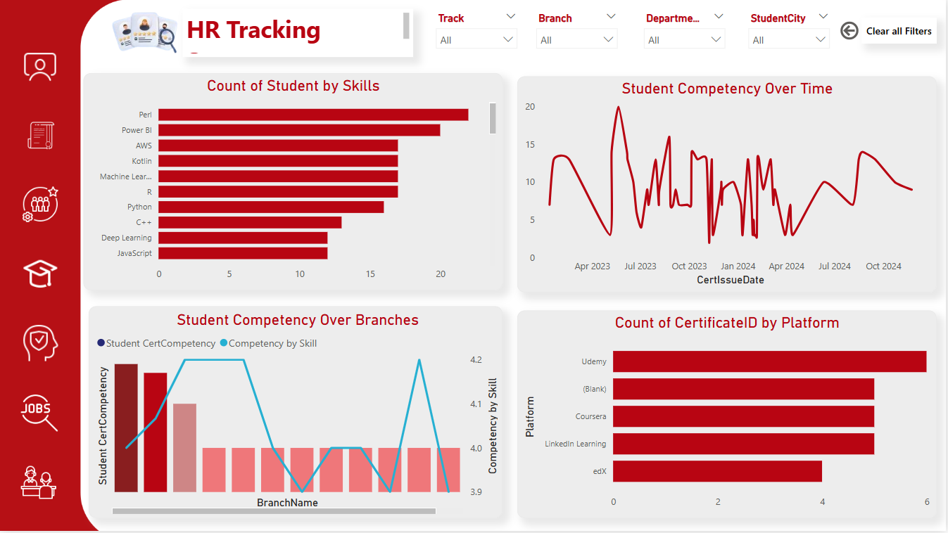

Slide 70
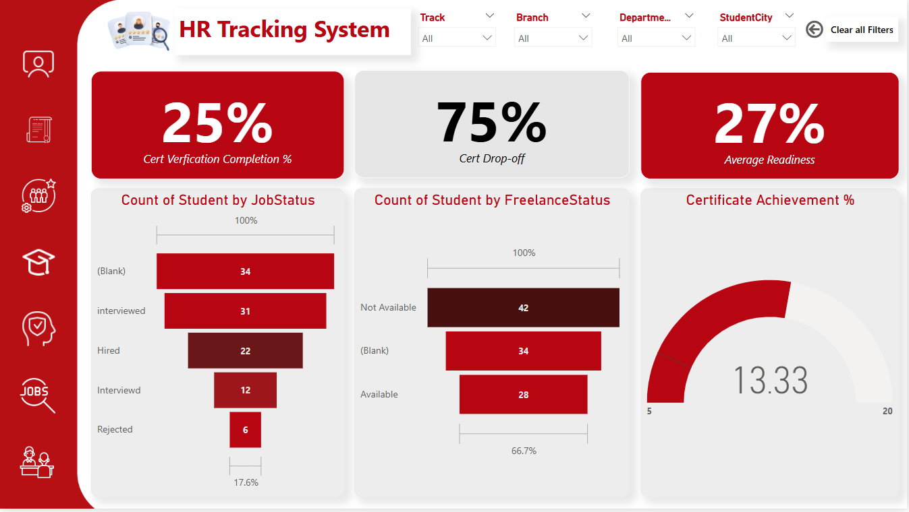

Slide 71
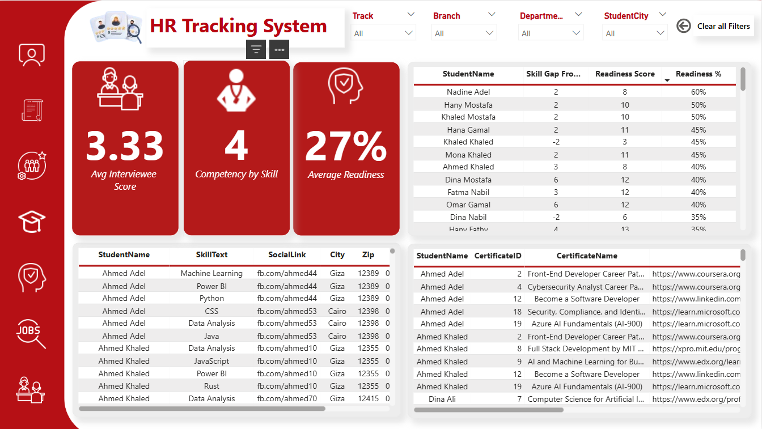

Slide 72


Slide 73
Student Dashboard

Slide 74


Slide 75


Slide 76


Slide 77


Slide 78


Slide 79


Slide 80

BI Chatbot Assistant

Slide 81

ChatBot PIPELINE

Slide 82


Slide 83


Slide 84


Slide 85


Slide 86


Slide 87


Slide 88

THANK YOU

